Slide 1

REST Web API using .Net 5
Viswanatha Swamy
LinkedIn: https://www.linkedin.com/in/viswanatha-swamy-b57326128/
Twitter: https://twitter.com/vishipayyallore
Dot Net Learners House

Slide 2
Information
I am still a learner. Apologize if I do any mistake.
All the sessions will be hands on.
Will have parking lots for queries and other topics.
Some of the concepts we will be introduced and revisited in next sessions.
There are multiple ways to do, we will use one of the ways.
The focus was more on concepts and demos are kept simple.
Dot Net Learners House

Slide 3
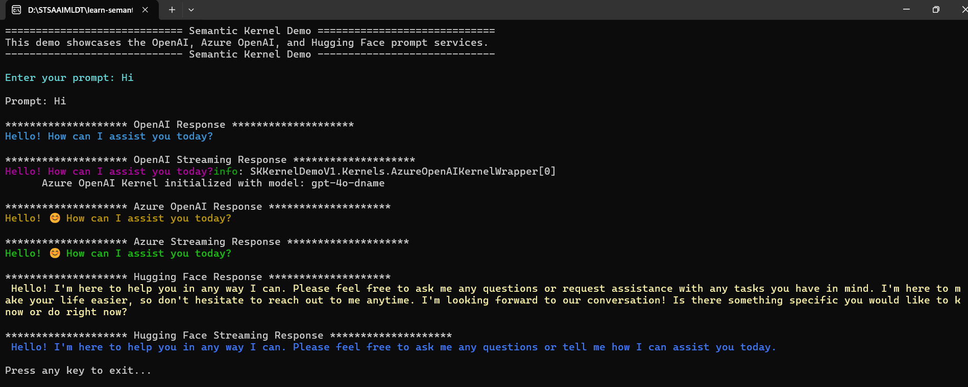

Slide 4
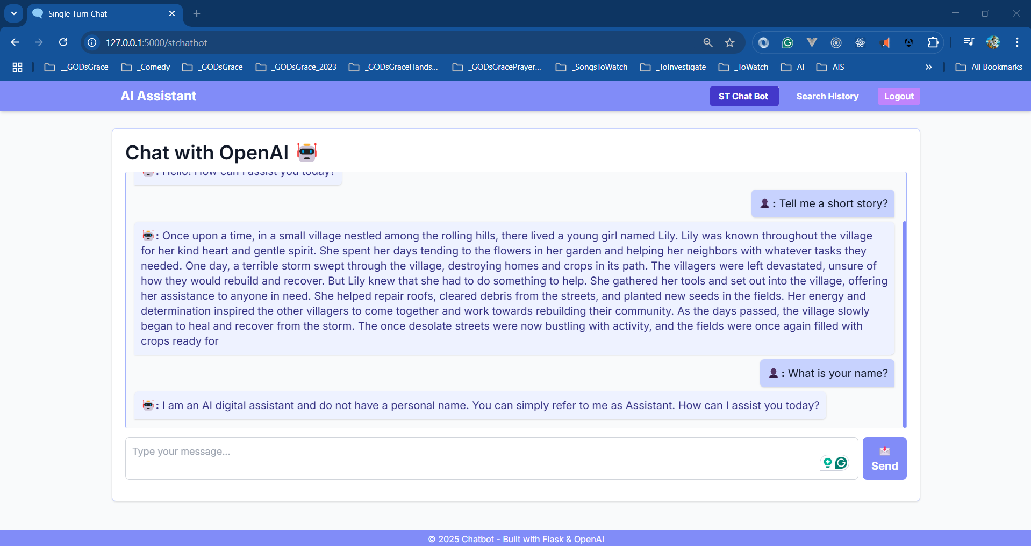

Slide 5
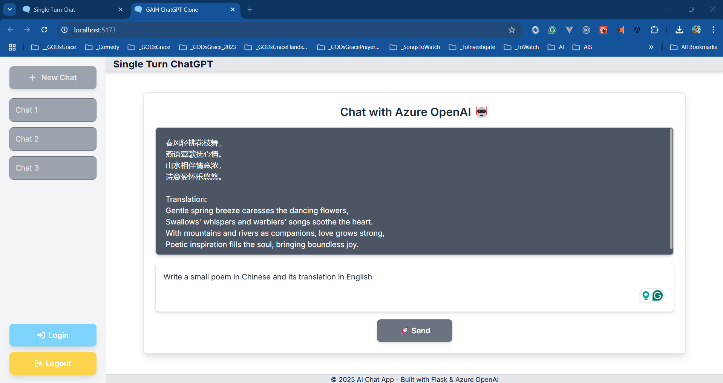

Slide 6
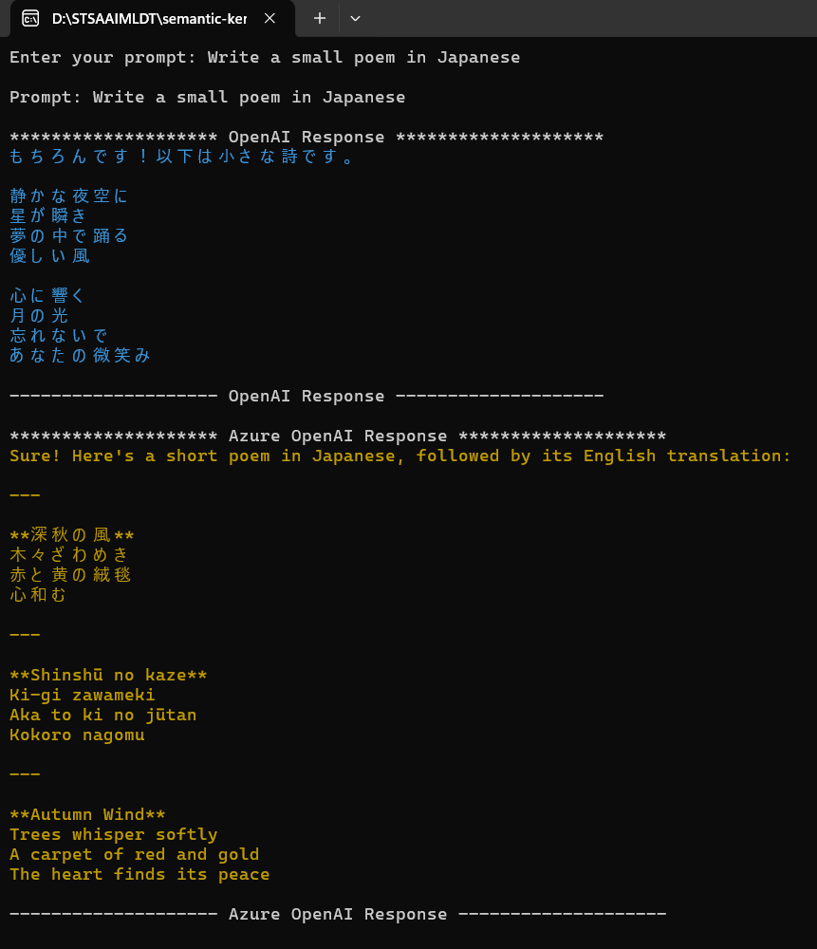

Slide 7
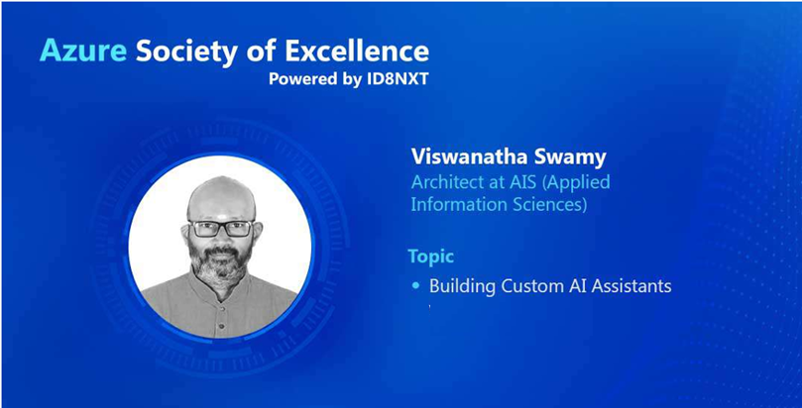

Slide 8

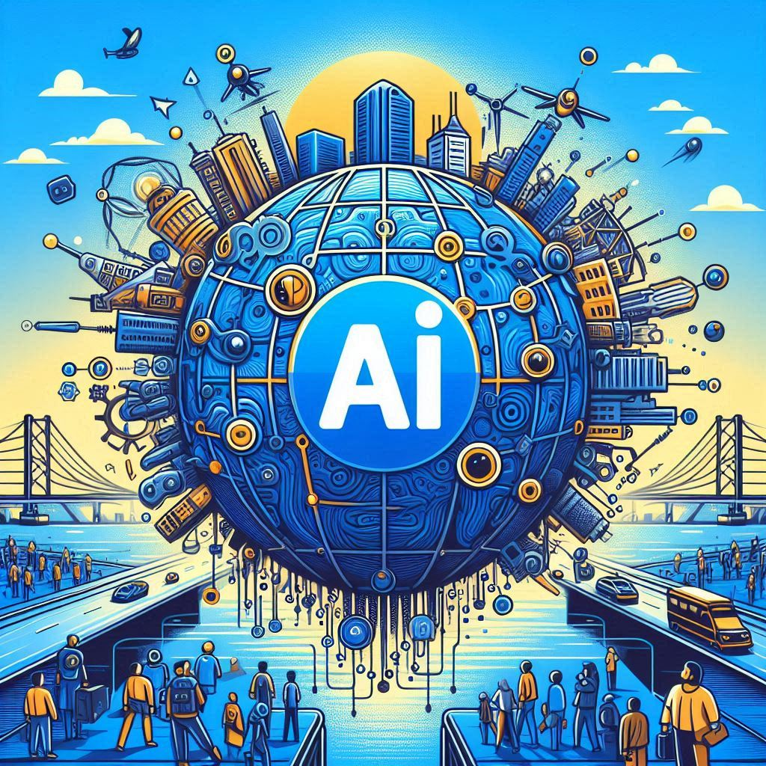
Global
Hyderabad

Slide 9
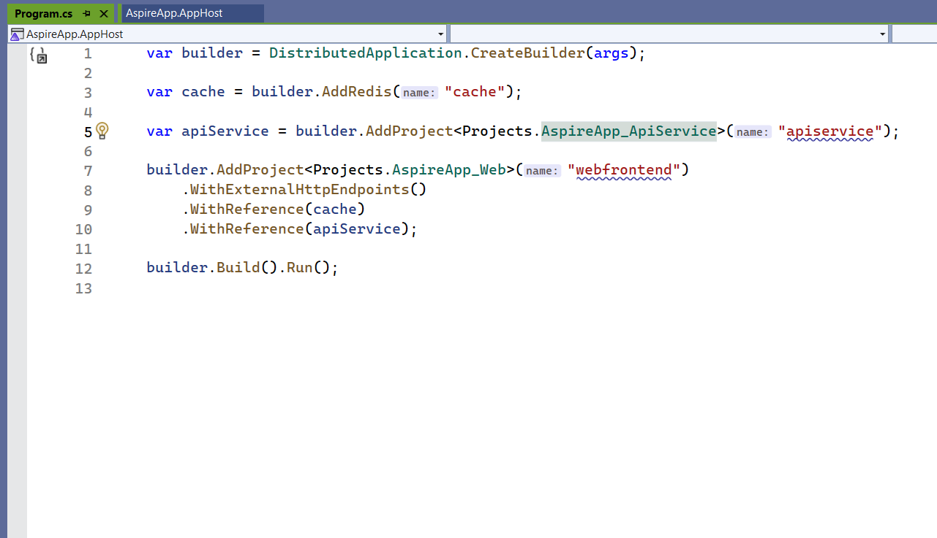
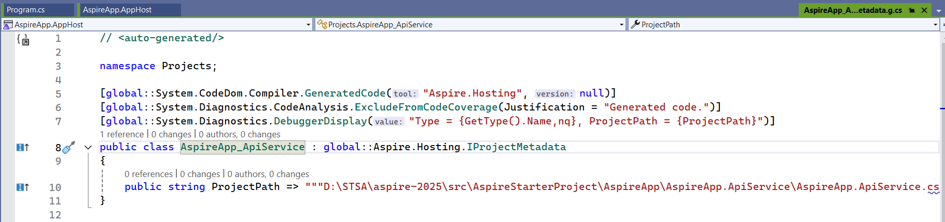

Slide 10
Please fasten
your
seat belt !!!
Dot Net Learners House

Slide 11
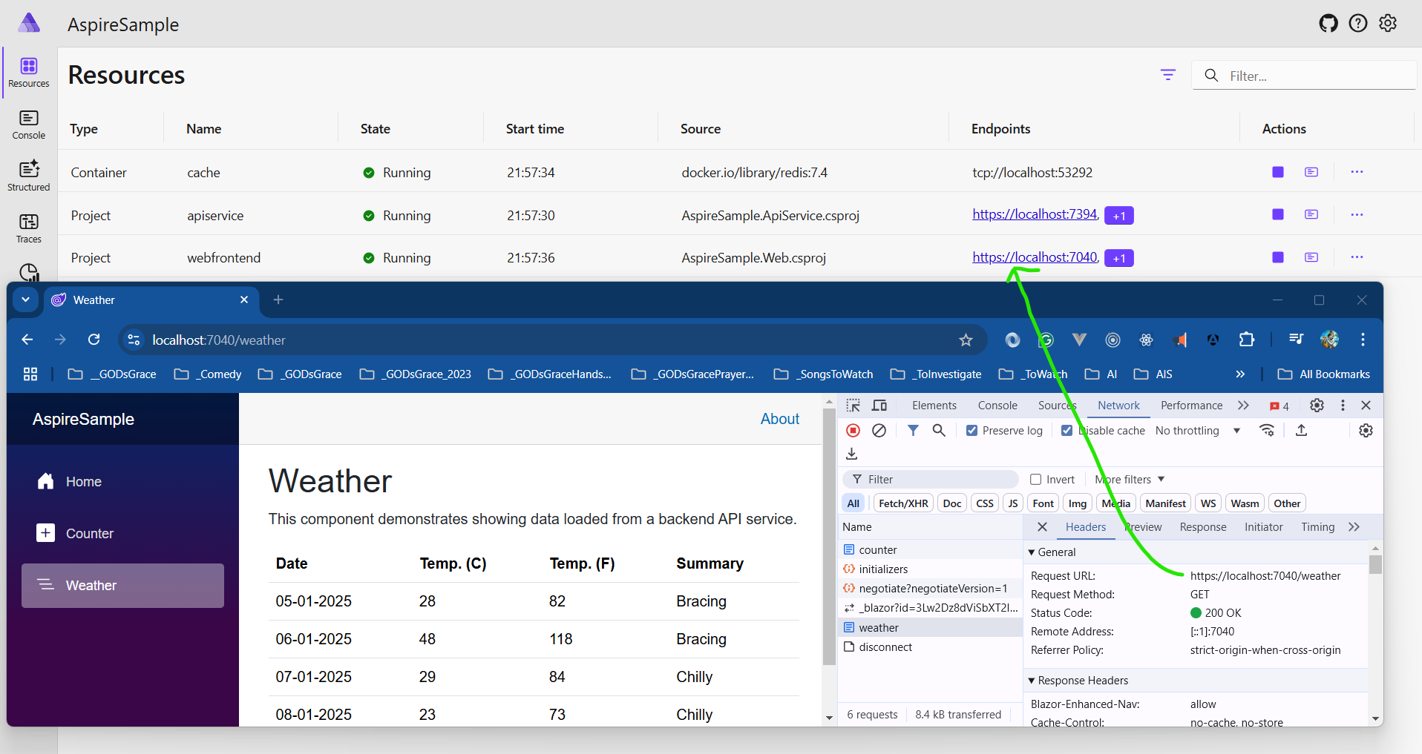

Slide 12
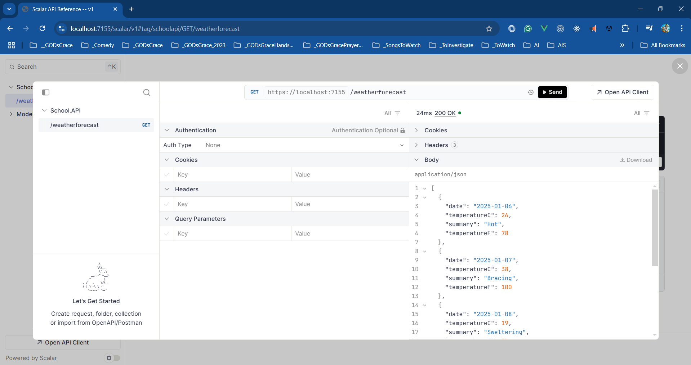

Slide 13
Information
I am still a learner. Apologize if I do any mistake.
All the sessions will be hands on.
Will have parking lots for queries and other topics.
Some of the concepts we will be introduced and revisited in next sessions.
There are multiple ways to do, we will use one of the ways.
The focus was more on concepts and demos are kept simple.
Dot Net Learners House

Slide 14
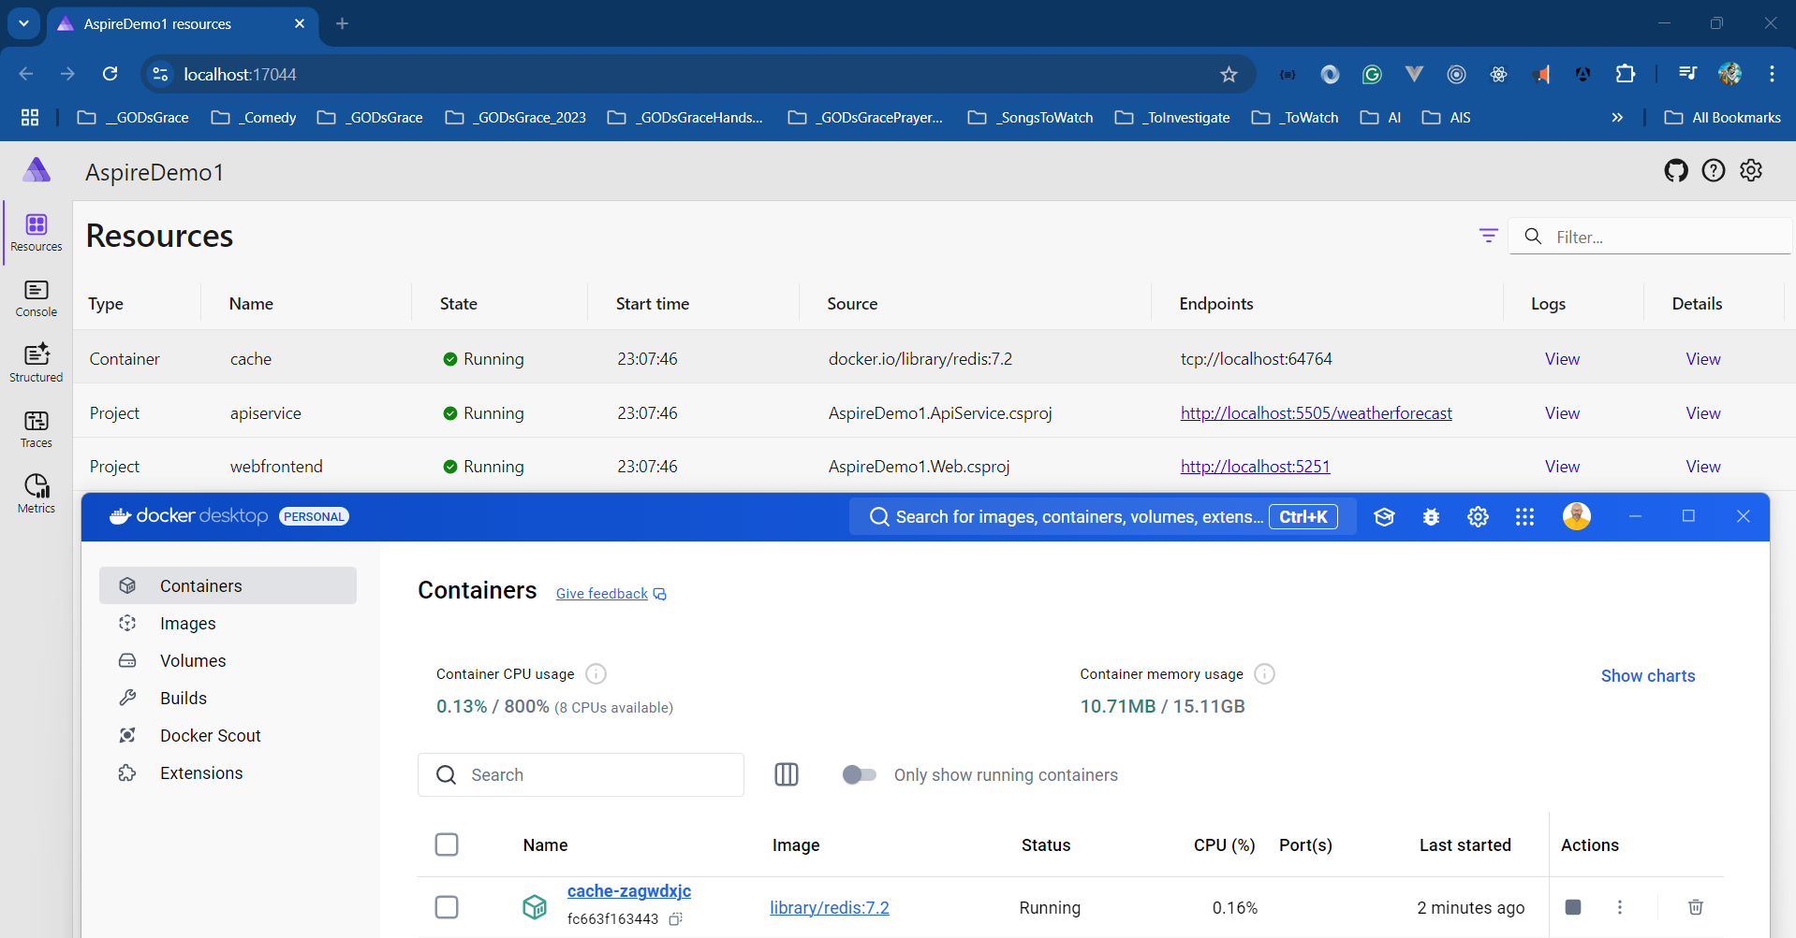

Slide 15
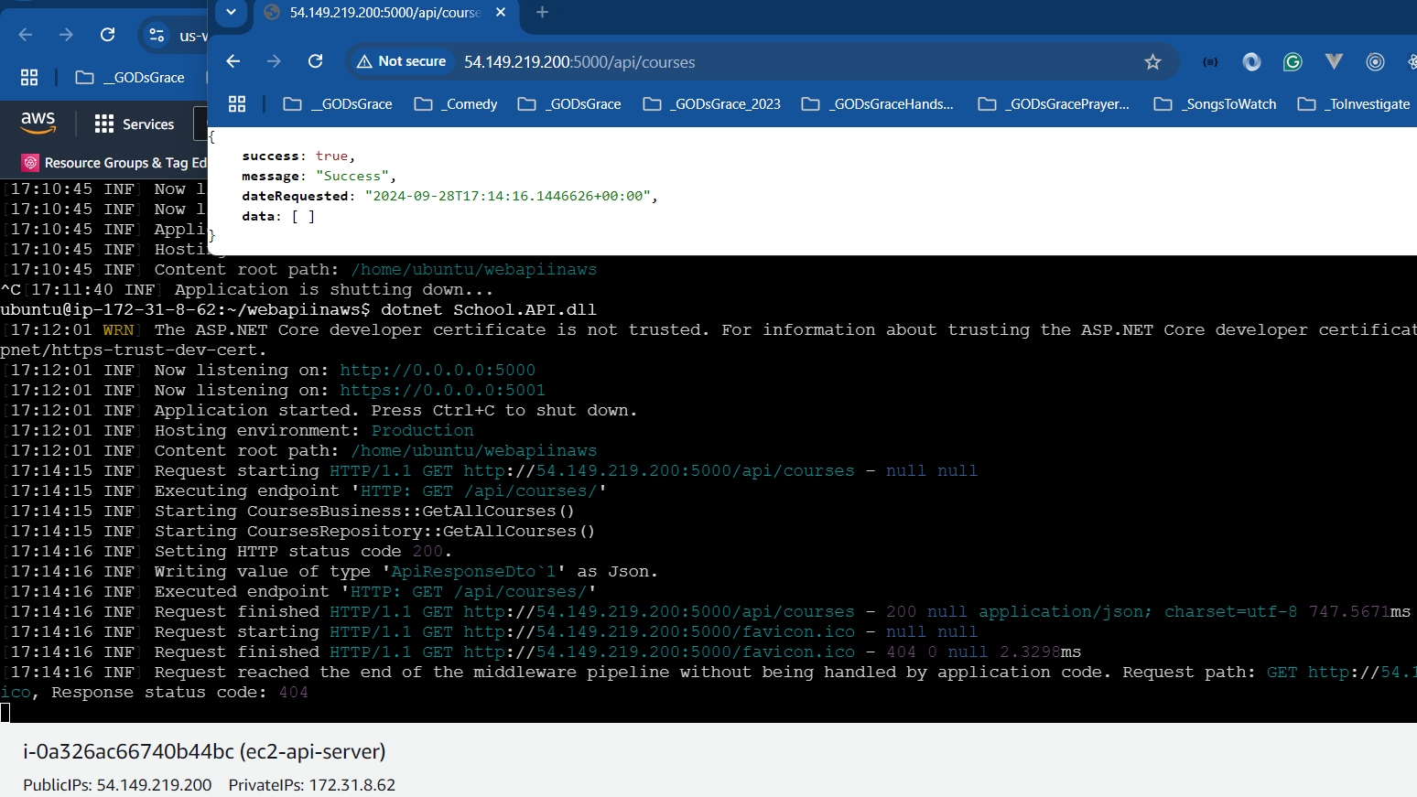

Slide 16
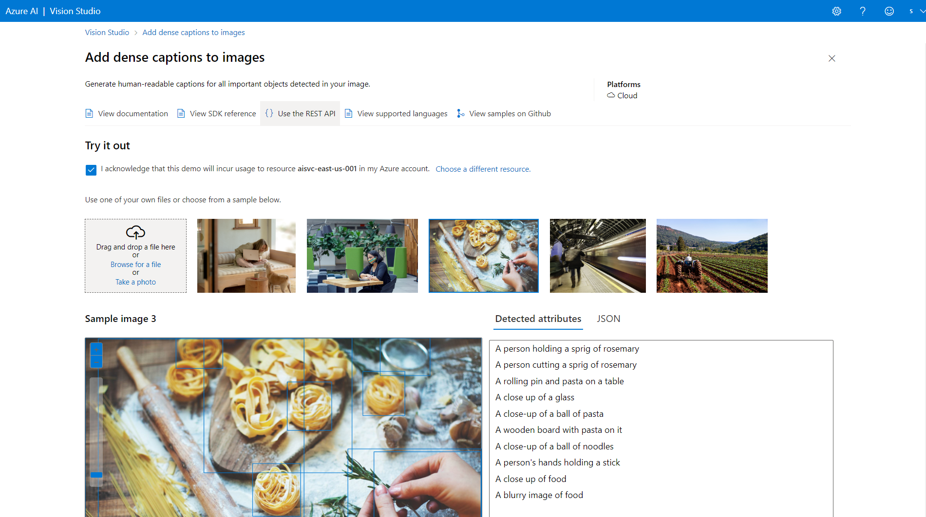

Slide 17
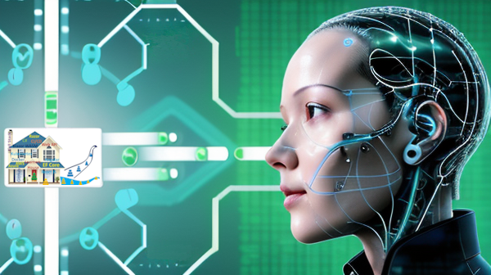

Slide 18
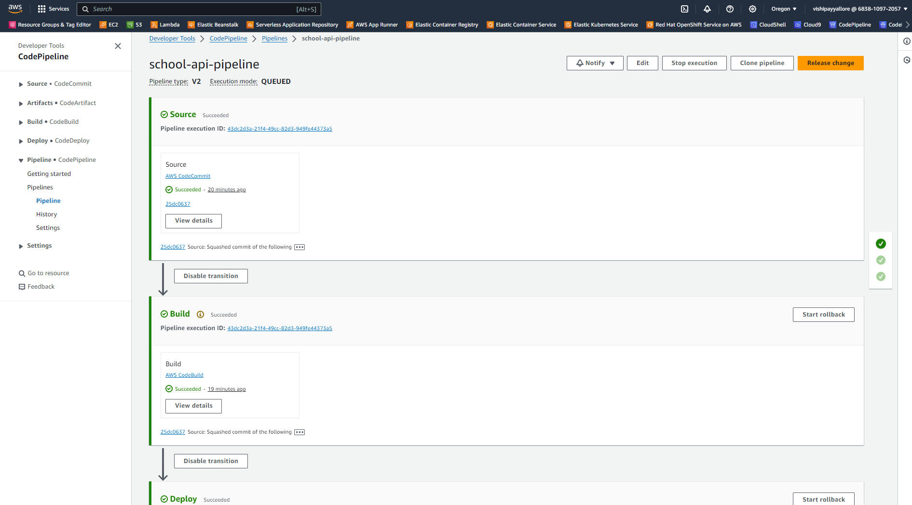

Slide 19




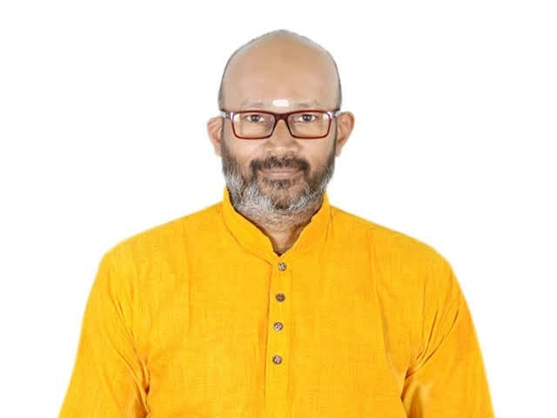
Dotnet Learners House
Series Introduction, and Getting started with Go
Thu, Apr 01, 2024
09:00 AM (IST)
Series Introduction, and Getting started with Go
Viswanatha Swamy
Architect - AIS
Event URL: https://bit.ly/3TwNRDo

Slide 20
Dotnet Learners House
AI 102 - Prepare, Create, and Consume Azure AI services
Thu, Mar 18, 2024
09:00 AM (IST)
AI 102 - Prepare, Create, and Consume Azure AI services
Viswanatha Swamy
Architect - AIS
Event URL: https://bit.ly/48Qes4d

Slide 21
Dotnet Learners House
MS SQL Server, Docker, Azure Data Studio, .NET 8, and EF Core
Thu, Feb 22, 2024
09:00 AM (IST)
MS SQL Server, Docker, Azure Data Studio, .NET 8, and EF Core
Viswanatha Swamy
Architect - AIS
Event URL: https://bit.ly/48mcYyl

Slide 22
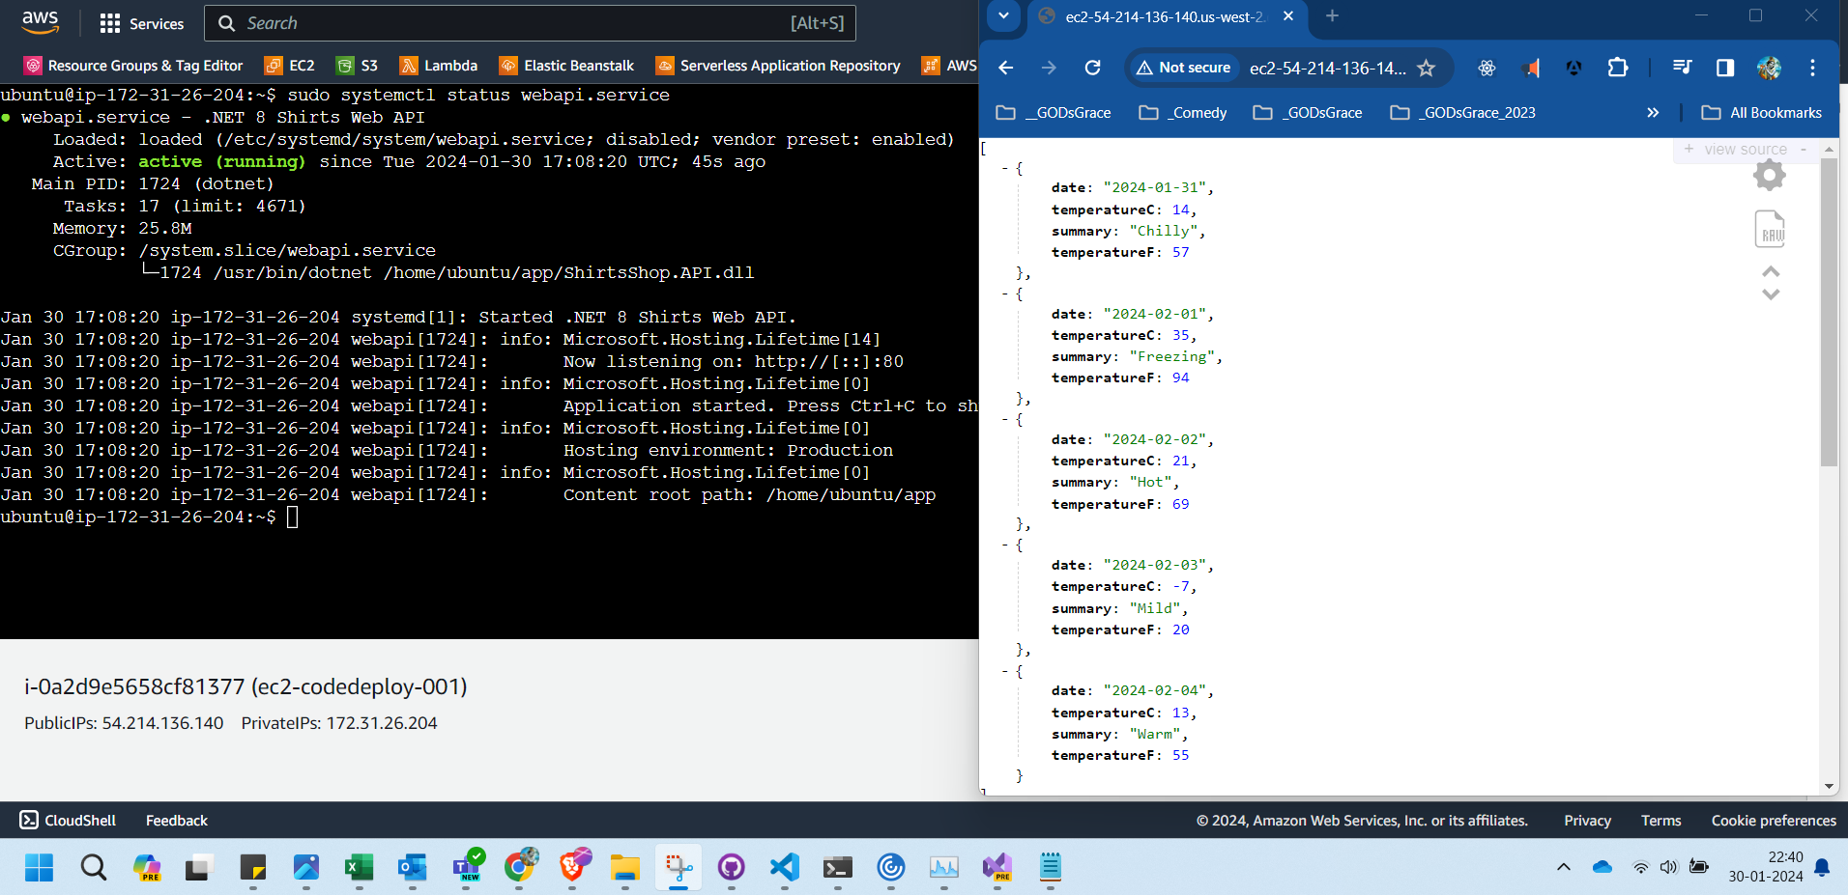
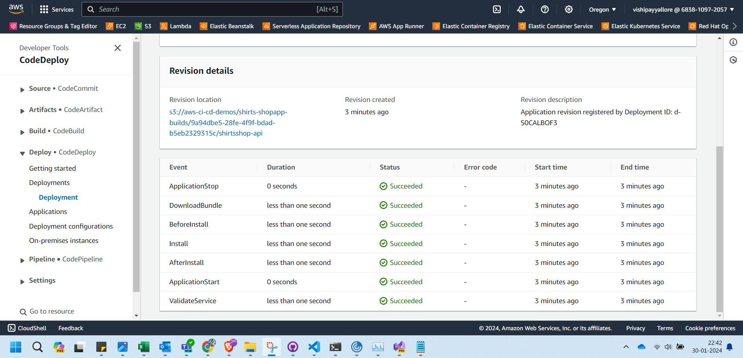

Slide 23





Reference Architecture
Client Apps
API Gateways / BFF
Identity Microservices
Event Bus (RabbitMQ / Kafka / Service Bus)
SQL Server
Mobile
React Native
Aggregator Web
Azure Open IA
Server Side
MVC
Razor
Blazor Server
Payment Microservices
Aggregator Mobile
Event Bus
SPA
Angular
ReactJS
Vue JS
Blazor WASM
Orders Microservices
MySQL
Discount Microservices
PostgreSQL
Basket Microservices
Admin Services
Redis
SPA
Admin UI
Health Check
Webhooks
Alerts / Monitoring
Products Microservices
Mongo

Slide 24


















Pull request, CI, and CD
Feature Branch
Code
Pull Request
Gated Build
Master Branch
CI Build
Artefacts drop
Environment A
Release

Slide 25
Dotnet Learners House
AWS - Code Commit, Build, Deploy with .NET 8 Minimal API
Mon, Feb 05, 2024
09:00 AM (IST)
AWS - Code Commit, Build, Deploy with .NET 8 Minimal API
Viswanatha Swamy
Architect - AIS
Event URL: https://bit.ly/4bdTSwY

Slide 26









Gimmicks Travels
3
2
4
5
1
6

Slide 27
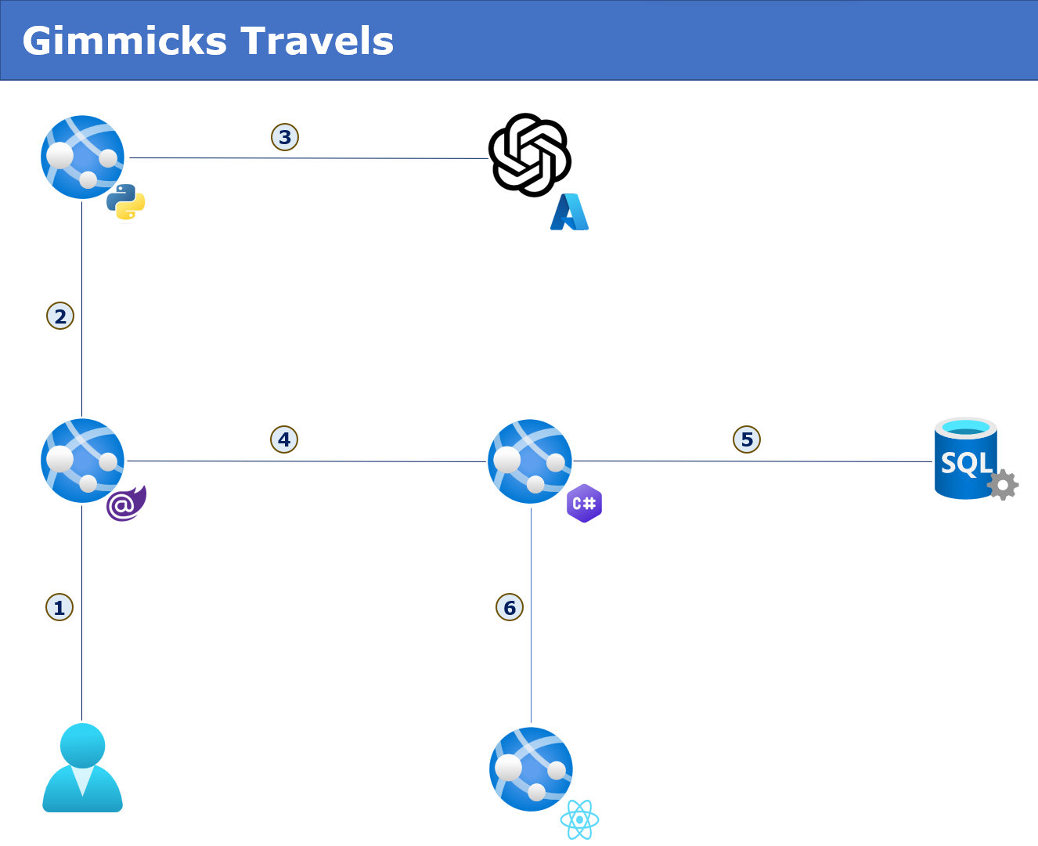

Slide 28
Dotnet Learners House
Microservices in .NET 8, and DAPR (Service to Service Invocation)
Mon, Jan 15, 2024
09:00 AM (IST)
Microservices in .NET 8, and DAPR (Service to Service Invocation)
Viswanatha Swamy
Architect - AIS
Event URL: https://bit.ly/3O1Gq5g

Slide 29
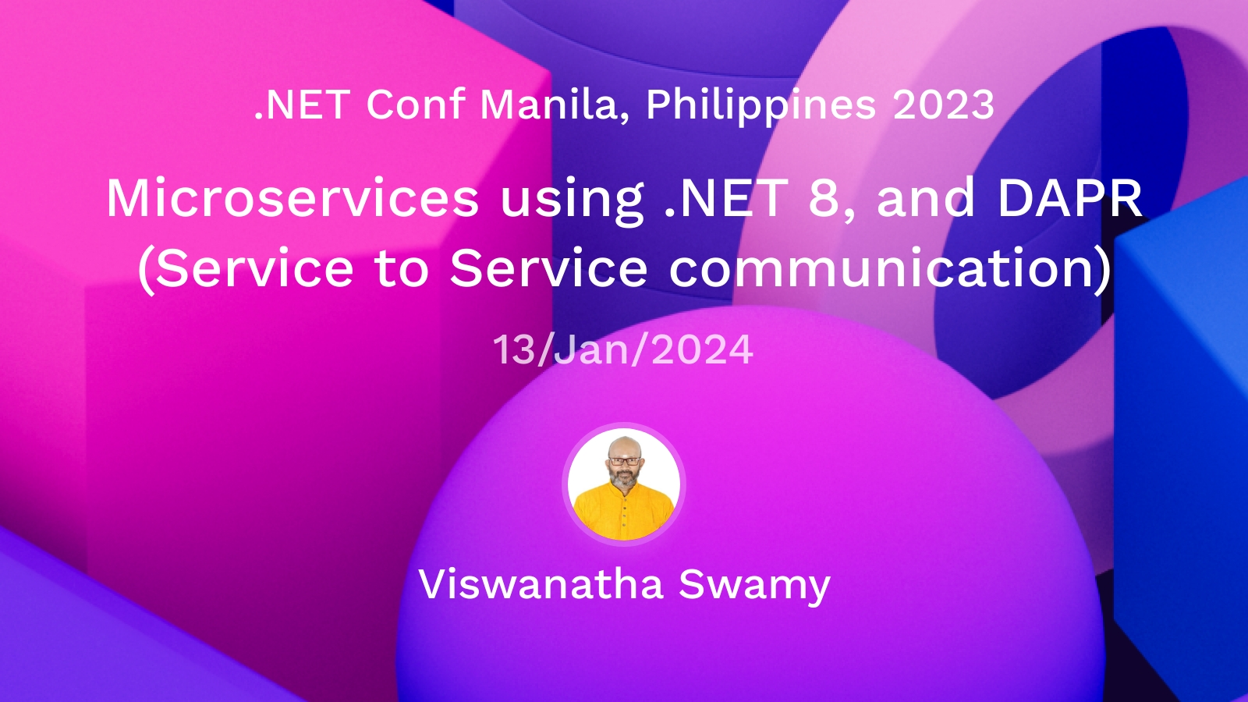

Slide 30
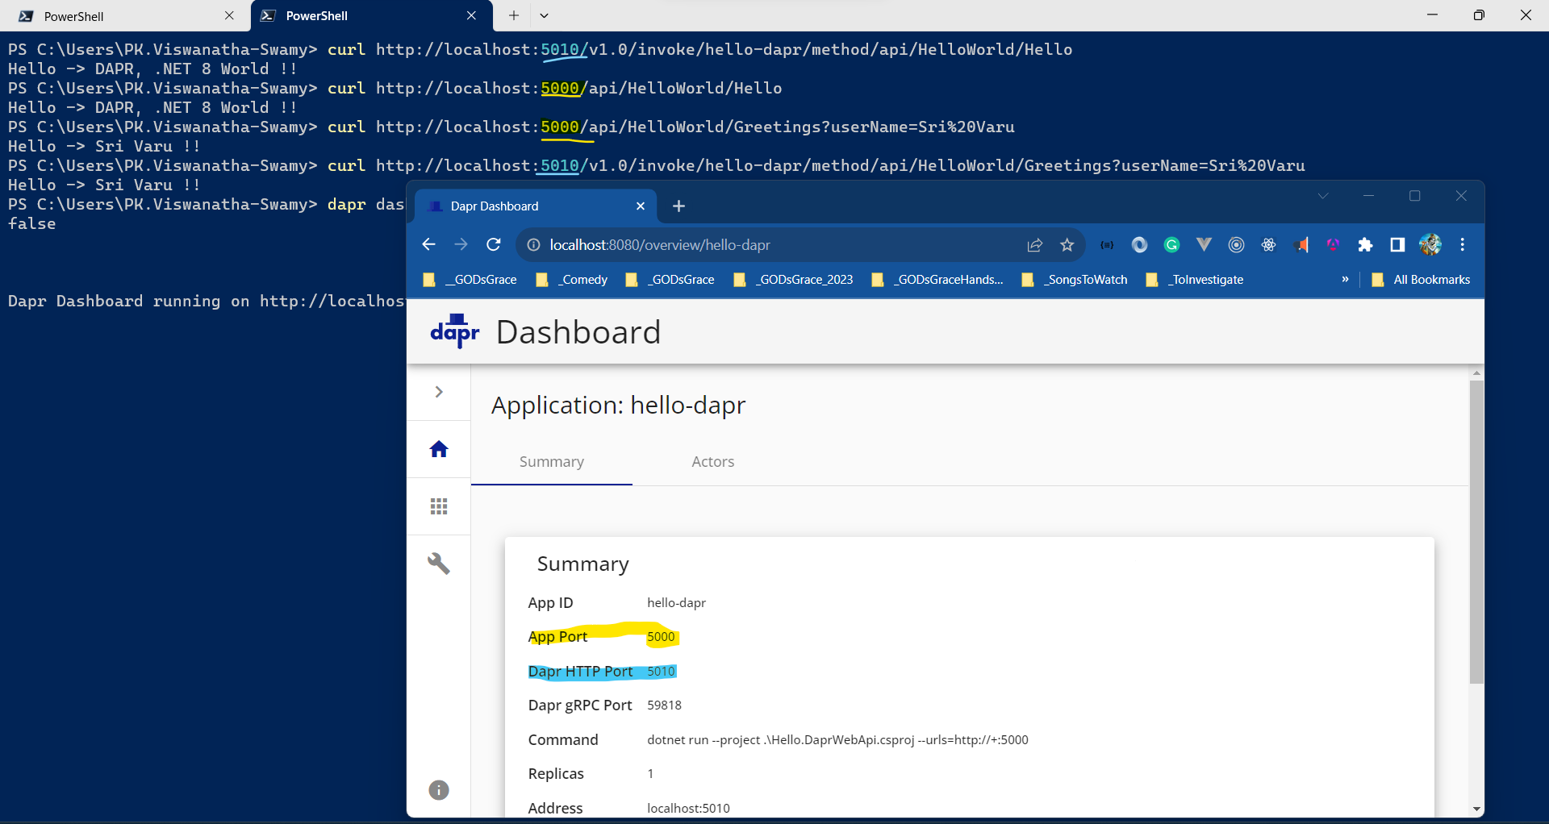

Slide 31
Dotnet Learners House
Dapr (Distributed Application Runtime), .NET 8, and VS Code
Mon, Nov 18, 2023
09:00 AM (IST)
Dapr (Distributed Application Runtime), .NET 8, and VS Code
Viswanatha Swamy
Architect - AIS
Event URL: https://bit.ly/3QHk2id

Slide 32
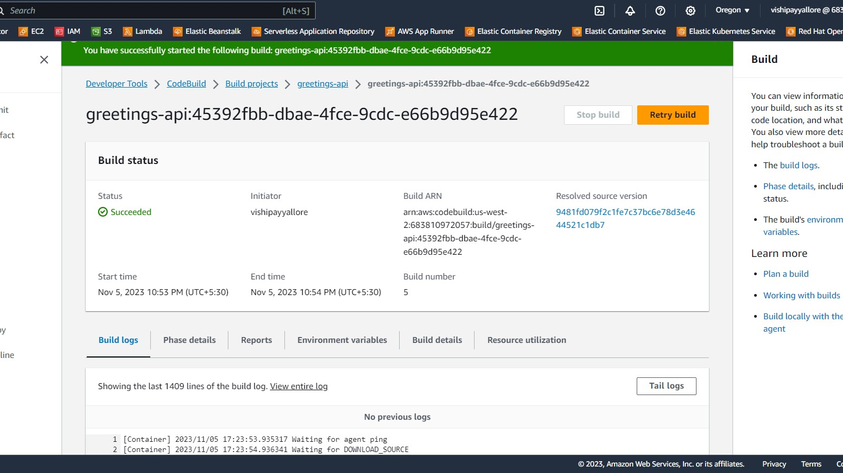

Slide 33
Dotnet Learners House
Hands-on with AWS - Code Build - .NET 8 / Java Spring Boot
Mon, Nov 06, 2023
09:00 AM (IST)
Hands-on with AWS - Code Build - .NET 8 / Java Spring Boot
Viswanatha Swamy
Architect - AIS
Event URL: https://bit.ly/3u49qlR

Slide 34
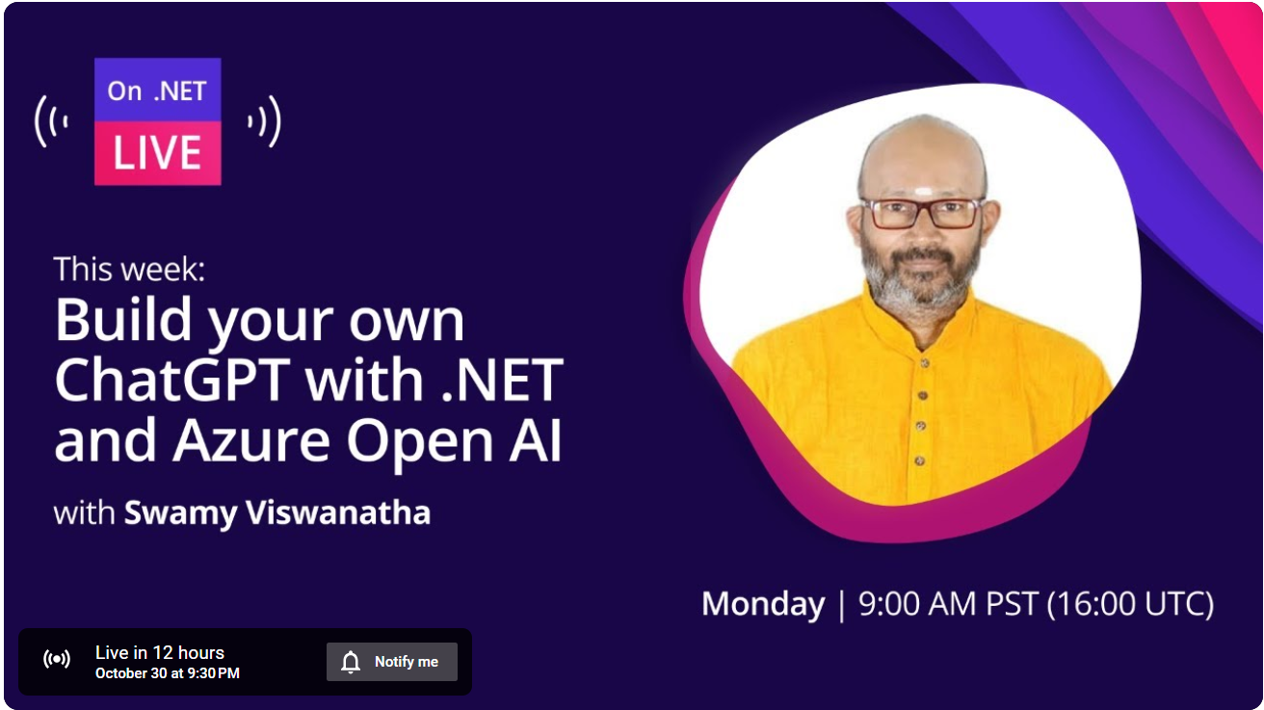

Slide 35
Travels
Py
AOAI
.NET 8
SQL
Blazor
Admin App
ReactJS / Nextjs

Slide 36
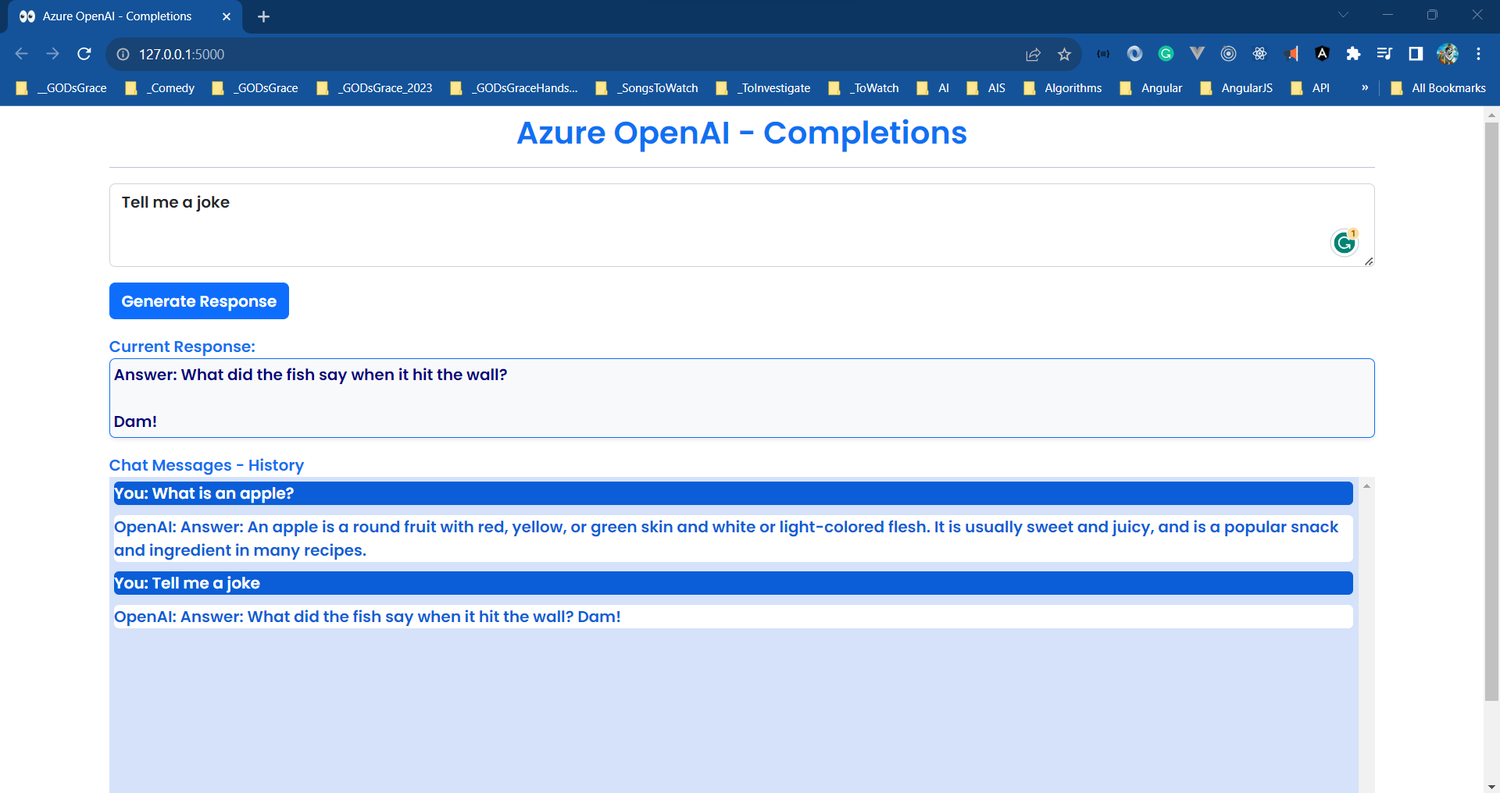

Slide 37
Dotnet Learners House
Chat GPT Clone - Flask, AOAI, HTML, JavaScript, Bootstrap 5.x
Sun, Oct 22, 2023
09:00 AM (IST)
Chat GPT Clone - Flask, AOAI, HTML, JavaScript, Bootstrap 5.x
Viswanatha Swamy
Architect - AIS
Event URL: https://bit.ly/3M7yRJm

Slide 38
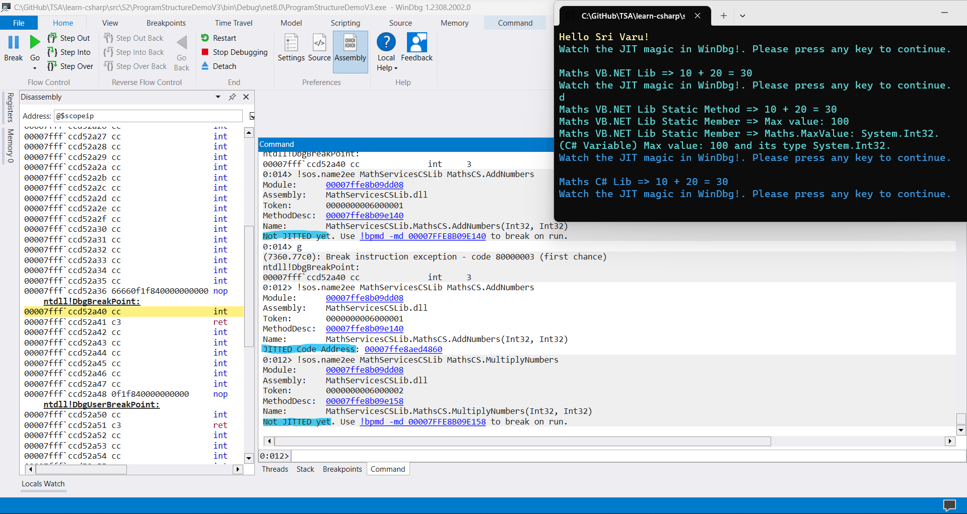

Slide 39
Dotnet Learners House
JIT Compilation .NET 6/7/8 Apps Basic Types and Conversions
Mon, Oct 09, 2023
09:00 AM (IST)
JIT Compilation .NET 6/7/8 Apps Basic Types and Conversions
Viswanatha Swamy
Architect - AIS
Event URL: https://bit.ly/3ttt2iN

Slide 40
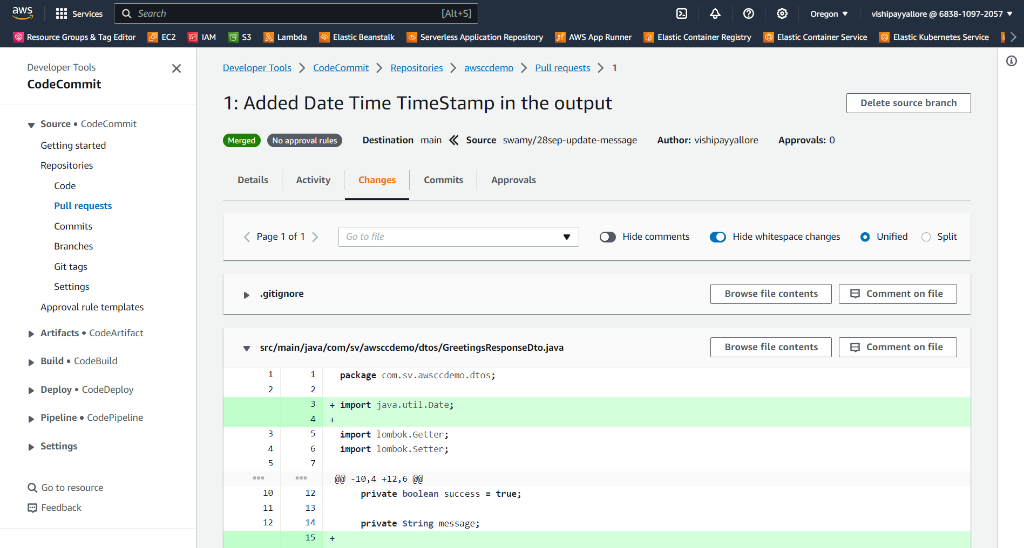

Slide 41
Dotnet Learners House
Hands-on with AWS - Code Commit - .NET 8 / Java Spring Boot
Sat, Sep 30, 2023
09:00 AM (IST)
Hands-on with AWS - Code Commit - .NET 8 / Java Spring Boot
Viswanatha Swamy
Architect - AIS
Event URL: https://bit.ly/46aXnkL

Slide 42
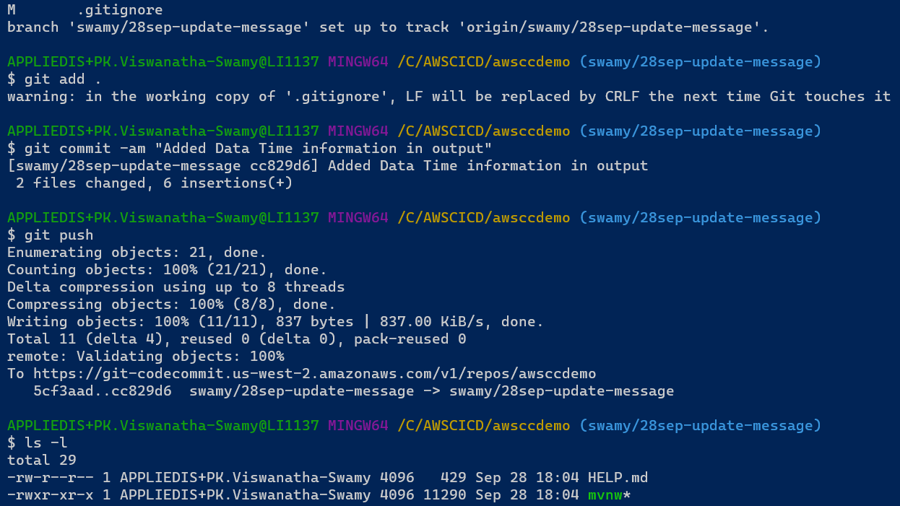

Slide 43
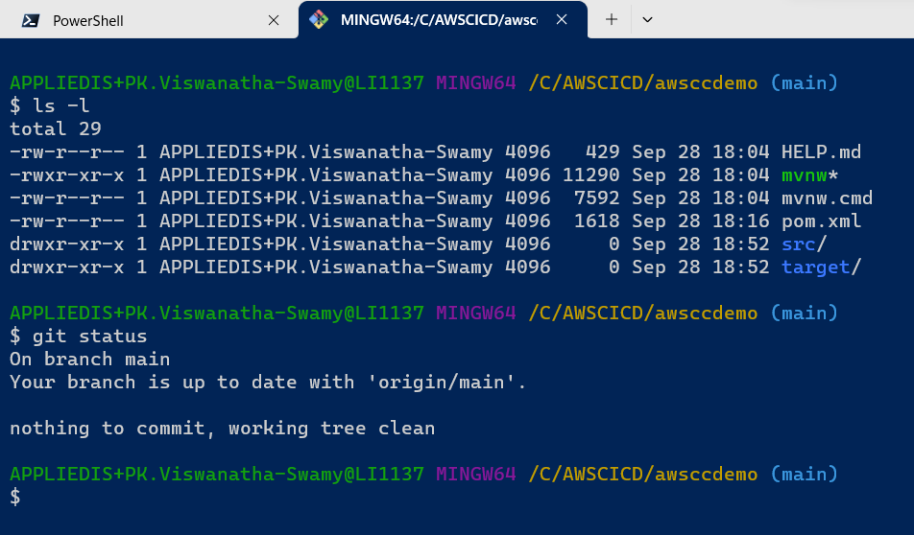

Slide 44
Dotnet Learners House
Interoperability, JIT Compilation, Debugging in VS Code
Mon, Aug 28, 2023
09:00 AM (IST)
Interoperability, JIT Compilation, Debugging in VS Code - 3 / 120
Viswanatha Swamy
Architect - AIS
Event URL: https://bit.ly/3P4TMgU

Slide 45
Source
Compiler
IL
JIT
0101

Slide 46
Front End
Middle Tier
Backend
Core
SQL
Blazor WASM
Angular
ReactJS
Vue.js
APP
API
/
gRPC
BLL
DAL
DMZ

Slide 47
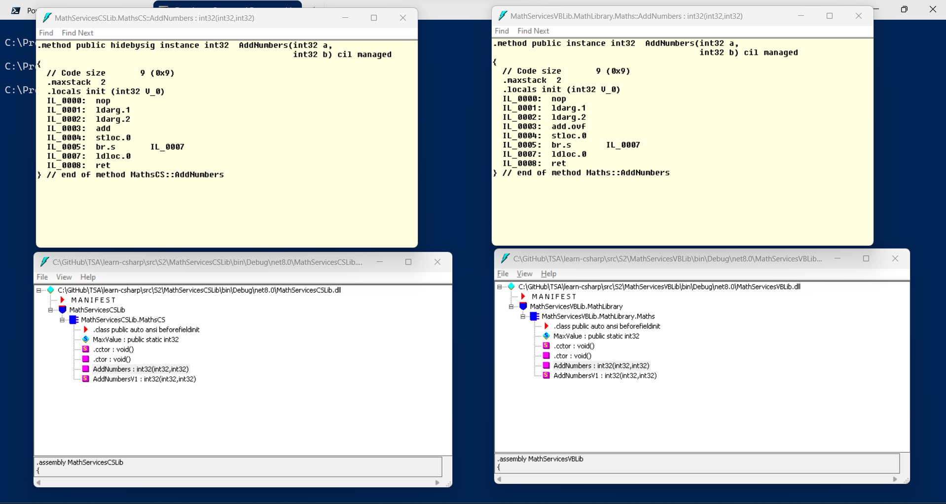

Slide 48
Dotnet Learners House
Interoperability, JIT Compilation, Debugging in VS Code
Mon, Aug 28, 2023
09:00 AM (IST)
Interoperability, JIT Compilation, Debugging in VS Code - 3 / 120
Viswanatha Swamy
Architect - AIS
Event URL: https://bit.ly/3P4TMgU

Slide 49
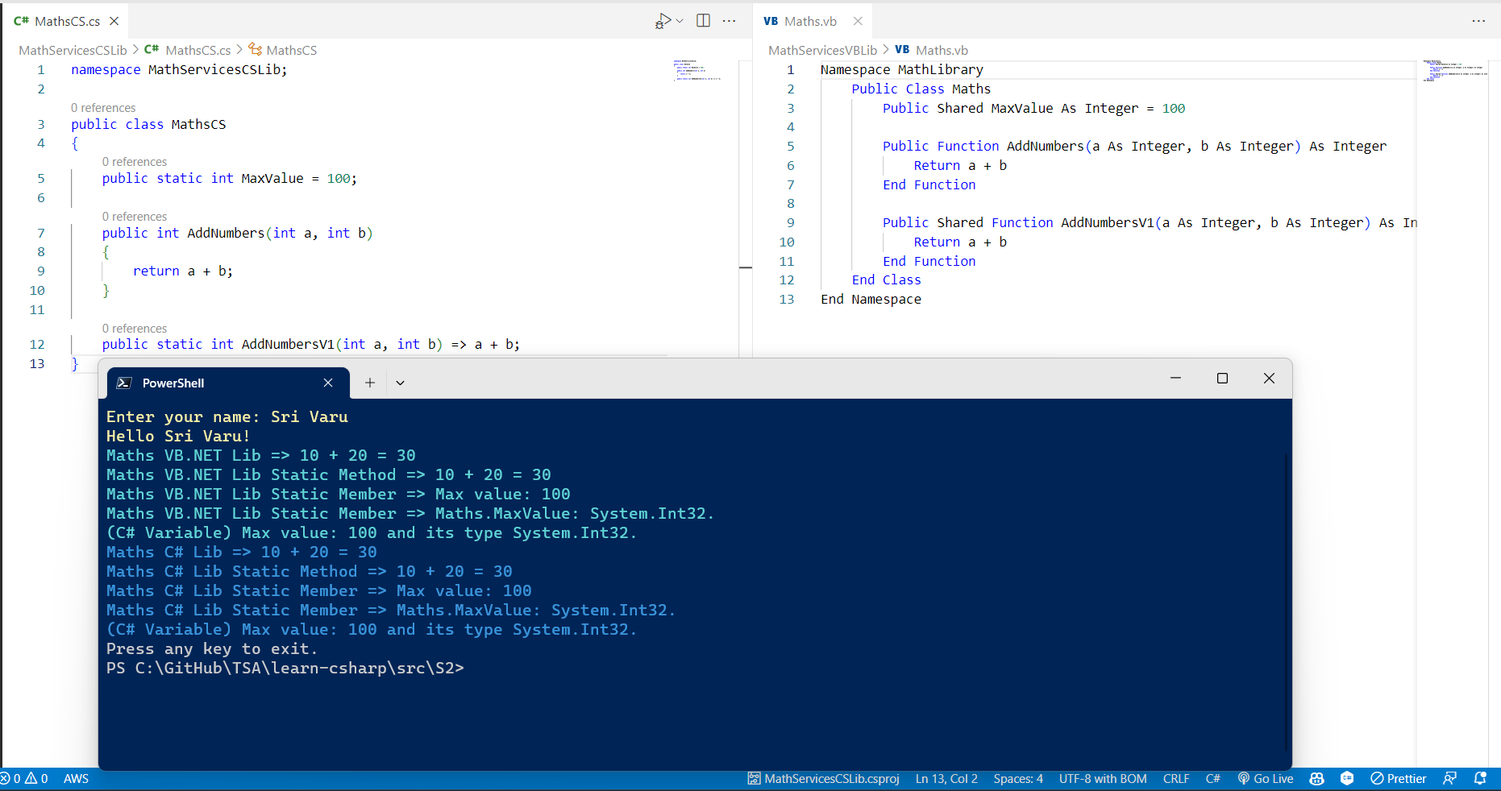

Slide 50
Dotnet Learners House
CTS, IL, JIT Compilation C# in .NET 8 - Microservices 2 / 120
Mon, Aug 28, 2023
09:00 AM (IST)
CTS, IL, JIT Compilation C# in .NET 8 - Microservices 2 / 120
Viswanatha Swamy
Architect - AIS
Event URL: https://bit.ly/3QWdY7i

Slide 51
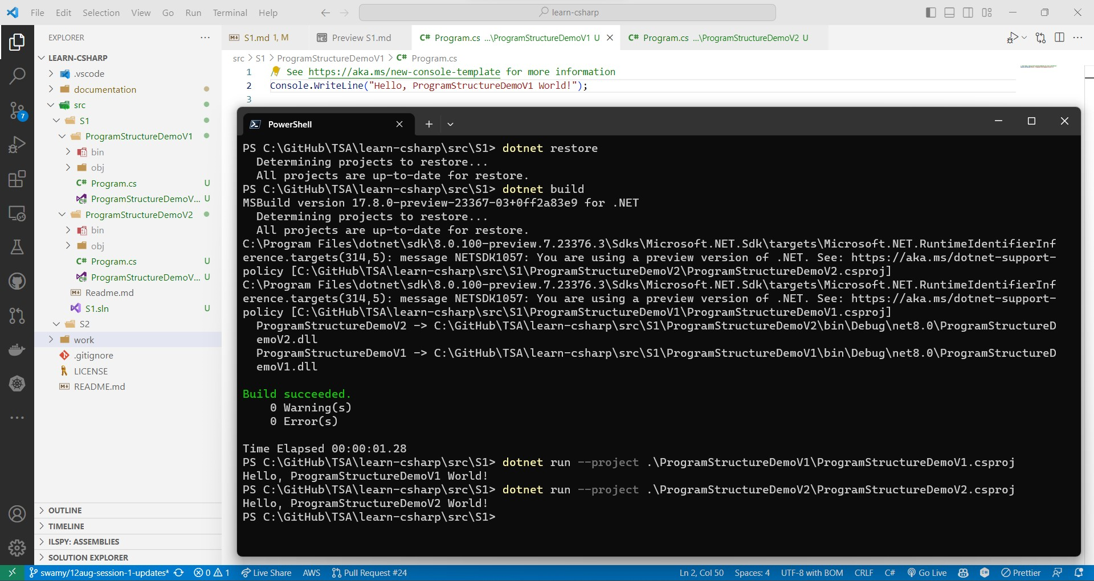

Slide 52
Dotnet Learners House
Getting started with C# in .NET 8 - Microservices Series 1 / 120
Mon, Aug 14, 2023
09:00 AM (IST)
Getting started with C# in .NET 8 - Microservices Series 1 / 120
Viswanatha Swamy
Architect - AIS
Event URL: https://bit.ly/3YAdC7S

Slide 53
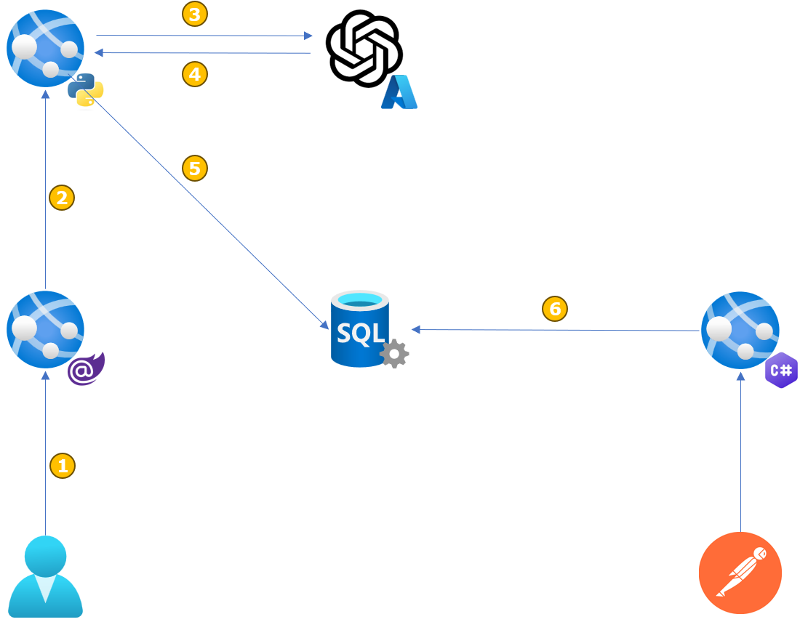

Slide 54

3
4
5
2
6
1

Slide 55
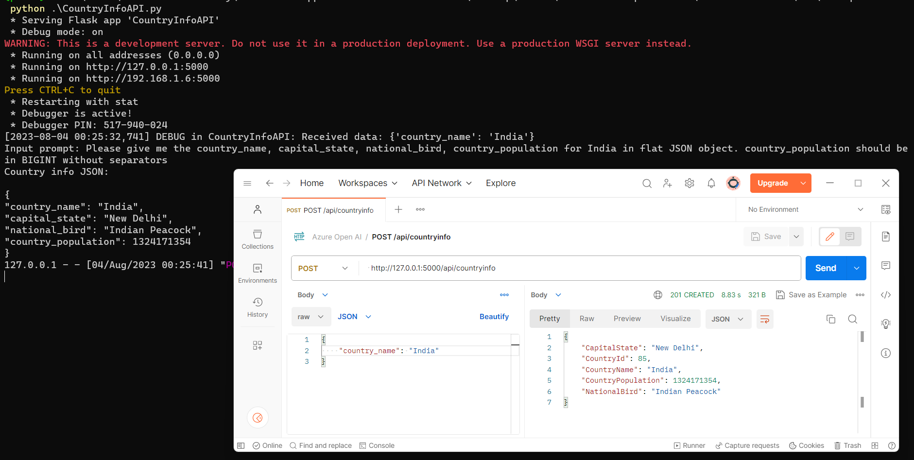

Slide 56
Dotnet Learners House
Azure OpenAI – Mini Project - Python/C#/Angular
Wed, Aug 07, 2023
09:00 AM (IST)
Azure OpenAI – Mini Project - Python/C#/Angular
Viswanatha Swamy
Architect - AIS
Event URL: https://bit.ly/3D1iGsd

Slide 57
Dotnet Learners House
Hands on with Amazon SageMaker Studio AutoML
Wed, Jul 31, 2023
09:00 AM (IST)
Hands on with Amazon SageMaker Studio AutoML
Viswanatha Swamy
Architect - AIS
Event URL: https://bit.ly/3Ozi2si

Slide 58
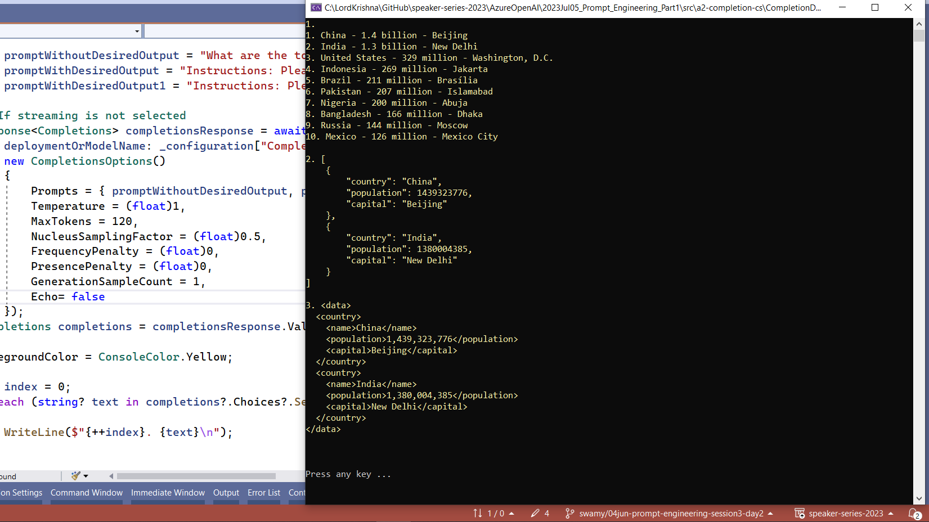

Slide 59
Dotnet Learners House
Azure OpenAI - Prompt Engineering - Studio/Postman/Python/C#
Wed, Jun 05, 2023
09:00 AM (IST)
Azure OpenAI - Prompt Engineering - Studio/Postman/Python/C#
Viswanatha Swamy
Architect - AIS
Event URL: https://bit.ly/3D1iGsd

Slide 60
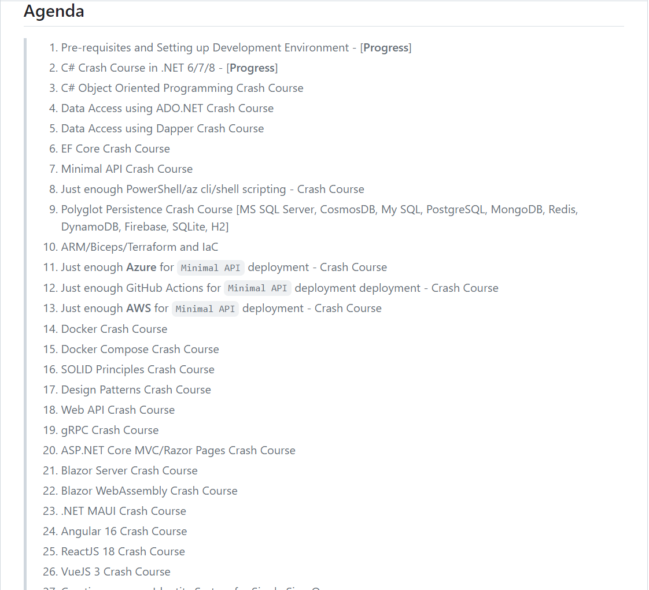

Slide 61
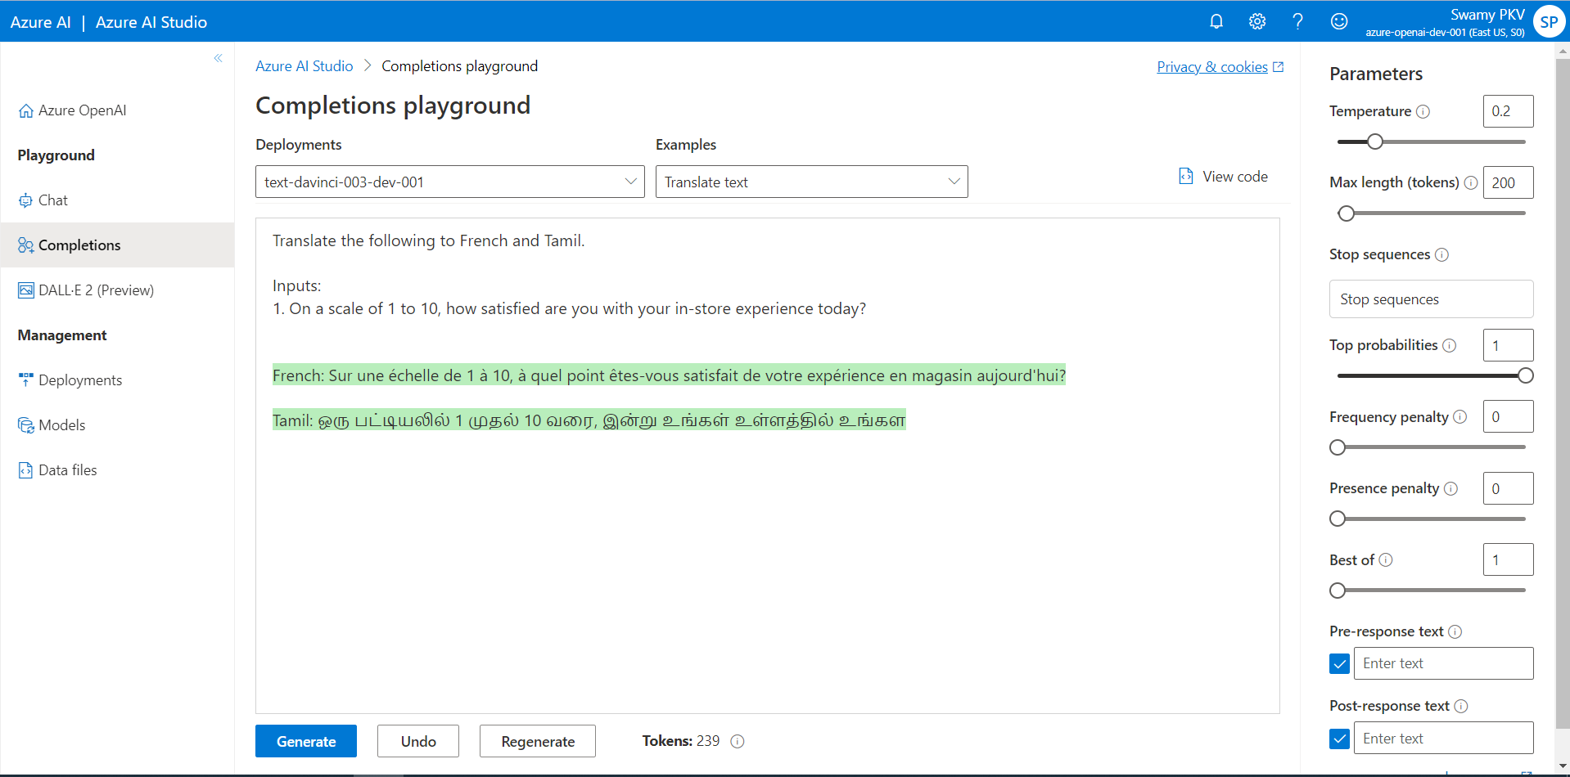
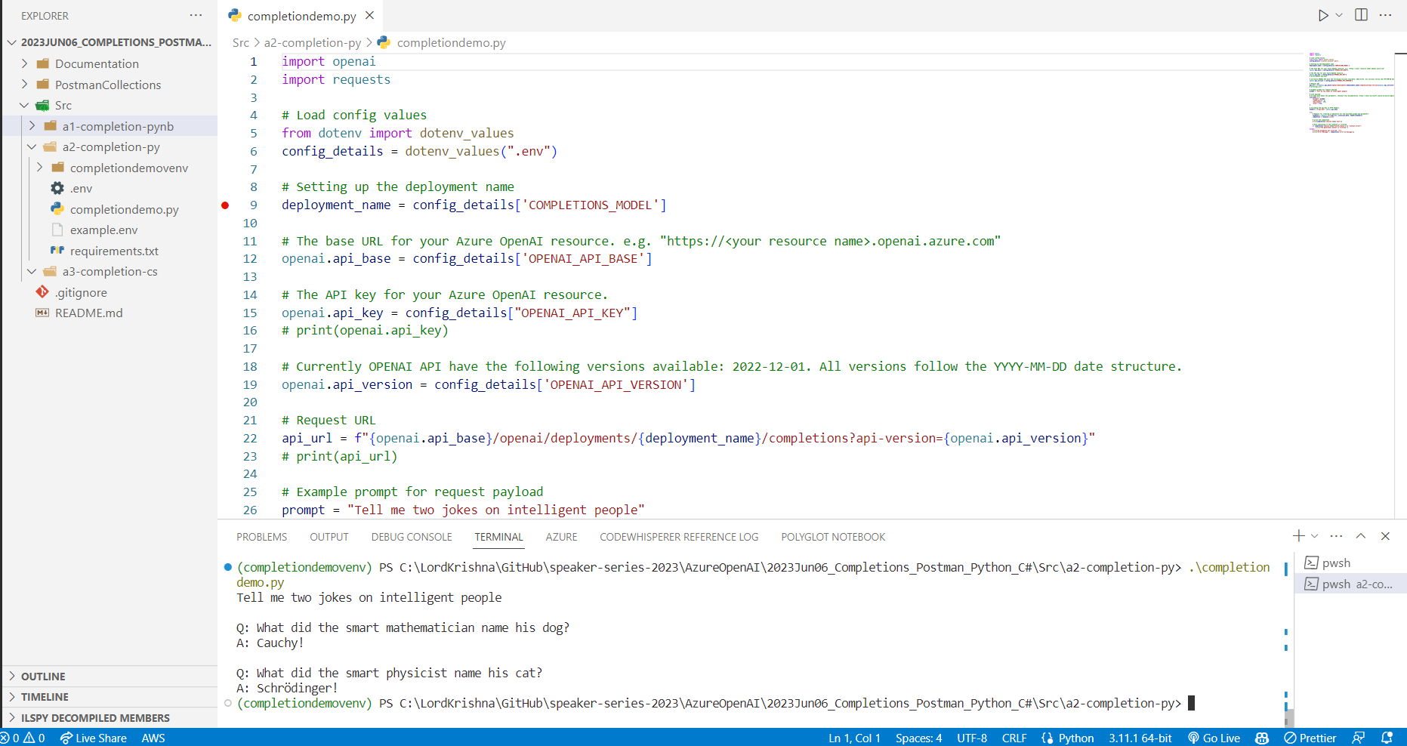

Slide 62
Dotnet Learners House
Azure OpenAI - Completion using Postman/Python/C# .NET 7
Wed, Jun 07, 2023
09:00 AM (IST)
Azure OpenAI - Completion using Postman/Python/C# .NET 7
Viswanatha Swamy
Architect - AIS
Event URL: https://bit.ly/42kUT0w

Slide 63
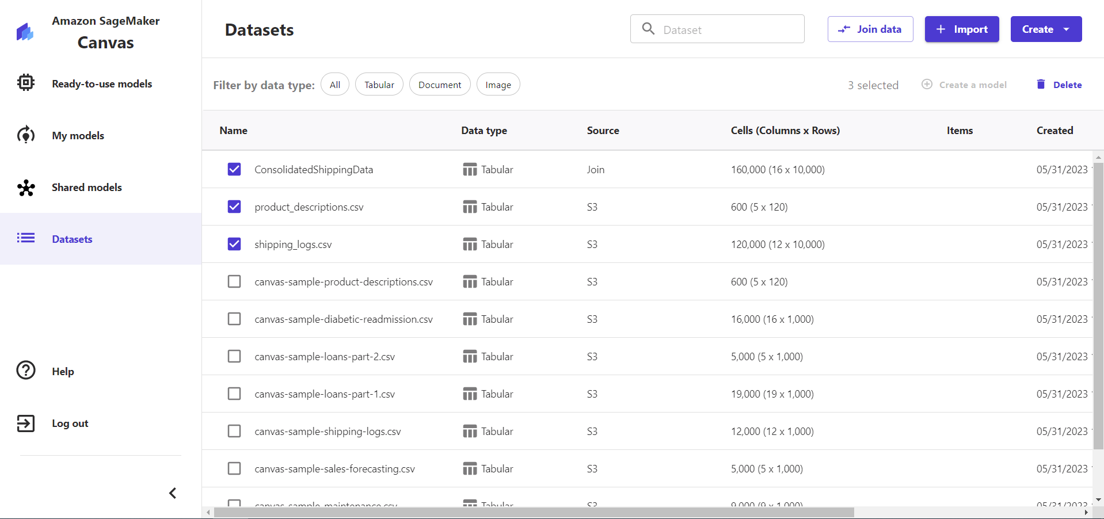

Slide 64
Dotnet Learners House
Hands-On - Getting Started with Amazon SageMaker Canvas
Wed, May 31, 2023
09:00 AM (IST)
Hands-On - Getting Started with Amazon SageMaker Canvas
Viswanatha Swamy
Architect - AIS
Event URL: https://bit.ly/43vB5Zs

Slide 66
Dotnet Learners House
Hands-On - Getting Started with Azure OpenAI
Sat, May 20, 2023
09:00 AM (IST)
Hands-On - Getting Started with Azure OpenAI
Viswanatha Swamy
Architect - AIS
Event URL: https://bit.ly/42QFKoV

Slide 67
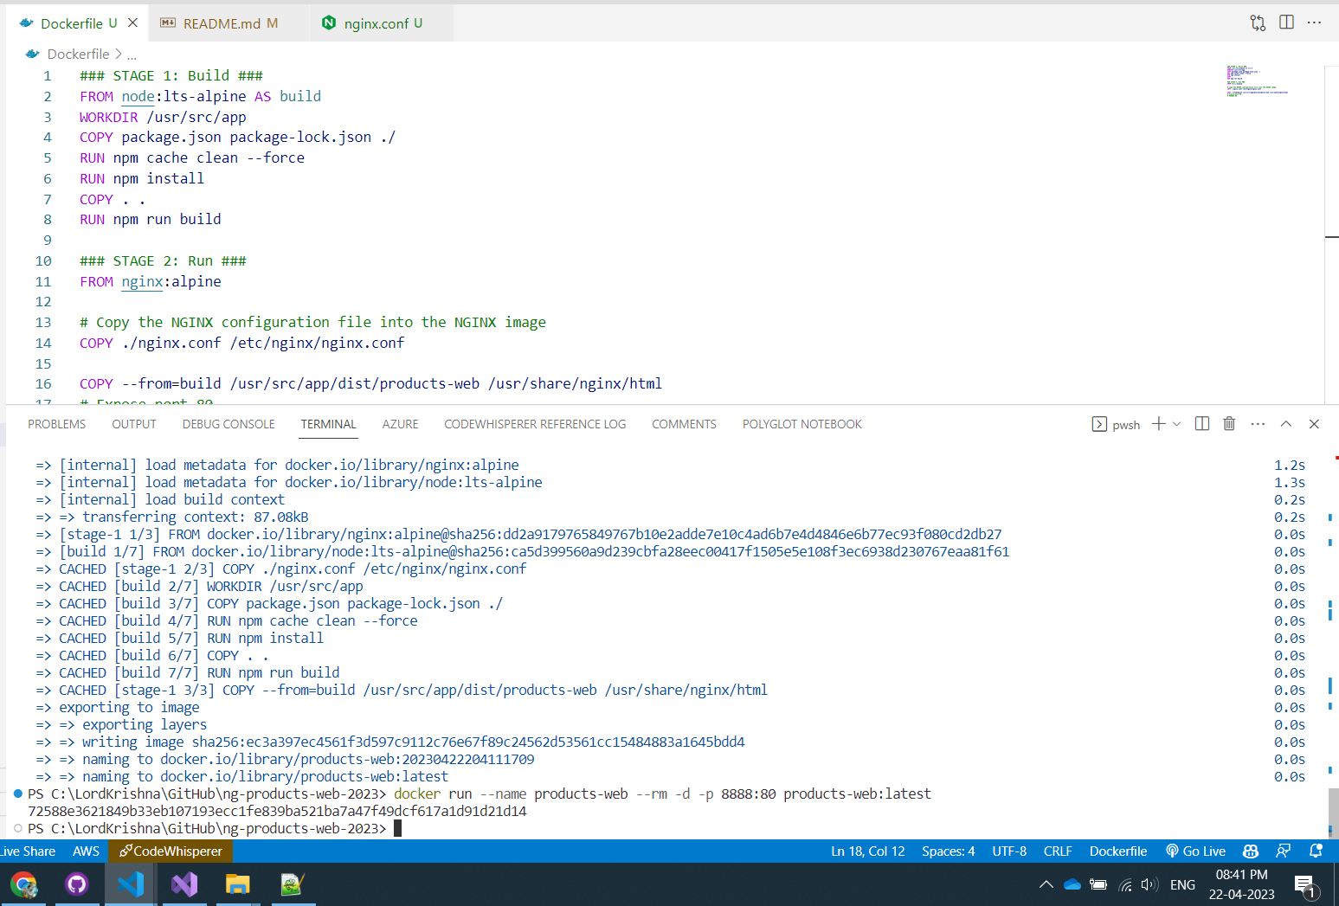

Slide 68
Dotnet Learners House
.NET 7 on AWS - Containerize .NET 7 and Angular 15 App
Sun, Aar 23, 2023
09:00 AM (IST)
.NET 7 on AWS - Containerize .NET 7 and Angular 15 App
Viswanatha Swamy
Architect - AIS
Event URL: https://bit.ly/3H639K8

Slide 69
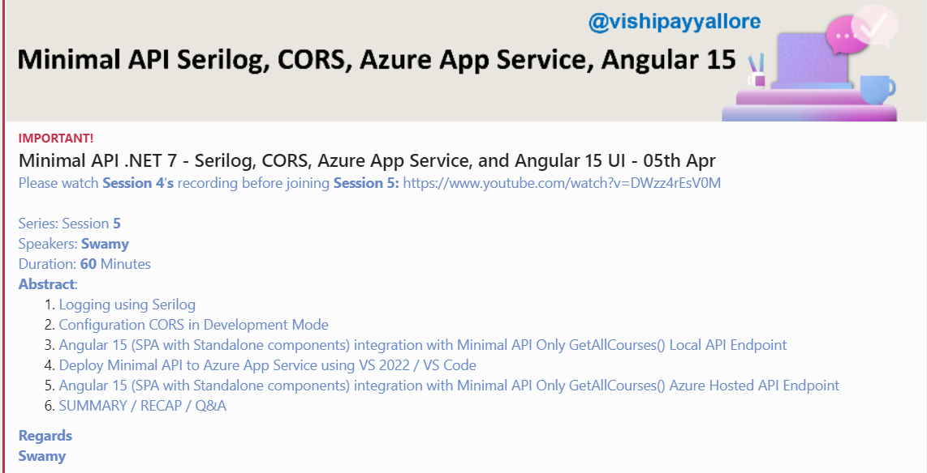

Slide 70
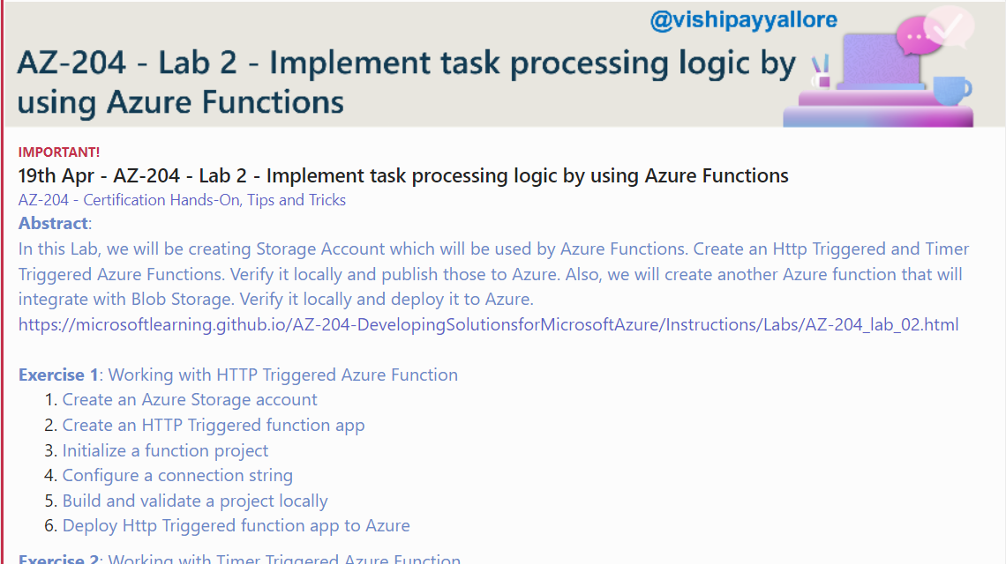

Slide 71
Dotnet Learners House
.NET 7 on AWS - MS SQL Server 2022 on AWS ECS using Fargate
Wed, Mar 29, 2023
09:00 AM (IST)
.NET 7 on AWS - MS SQL Server 2022 on AWS ECS using Fargate
Viswanatha Swamy
Architect - AIS
Event URL: http://bit.ly/3ZtFE3U

Slide 72
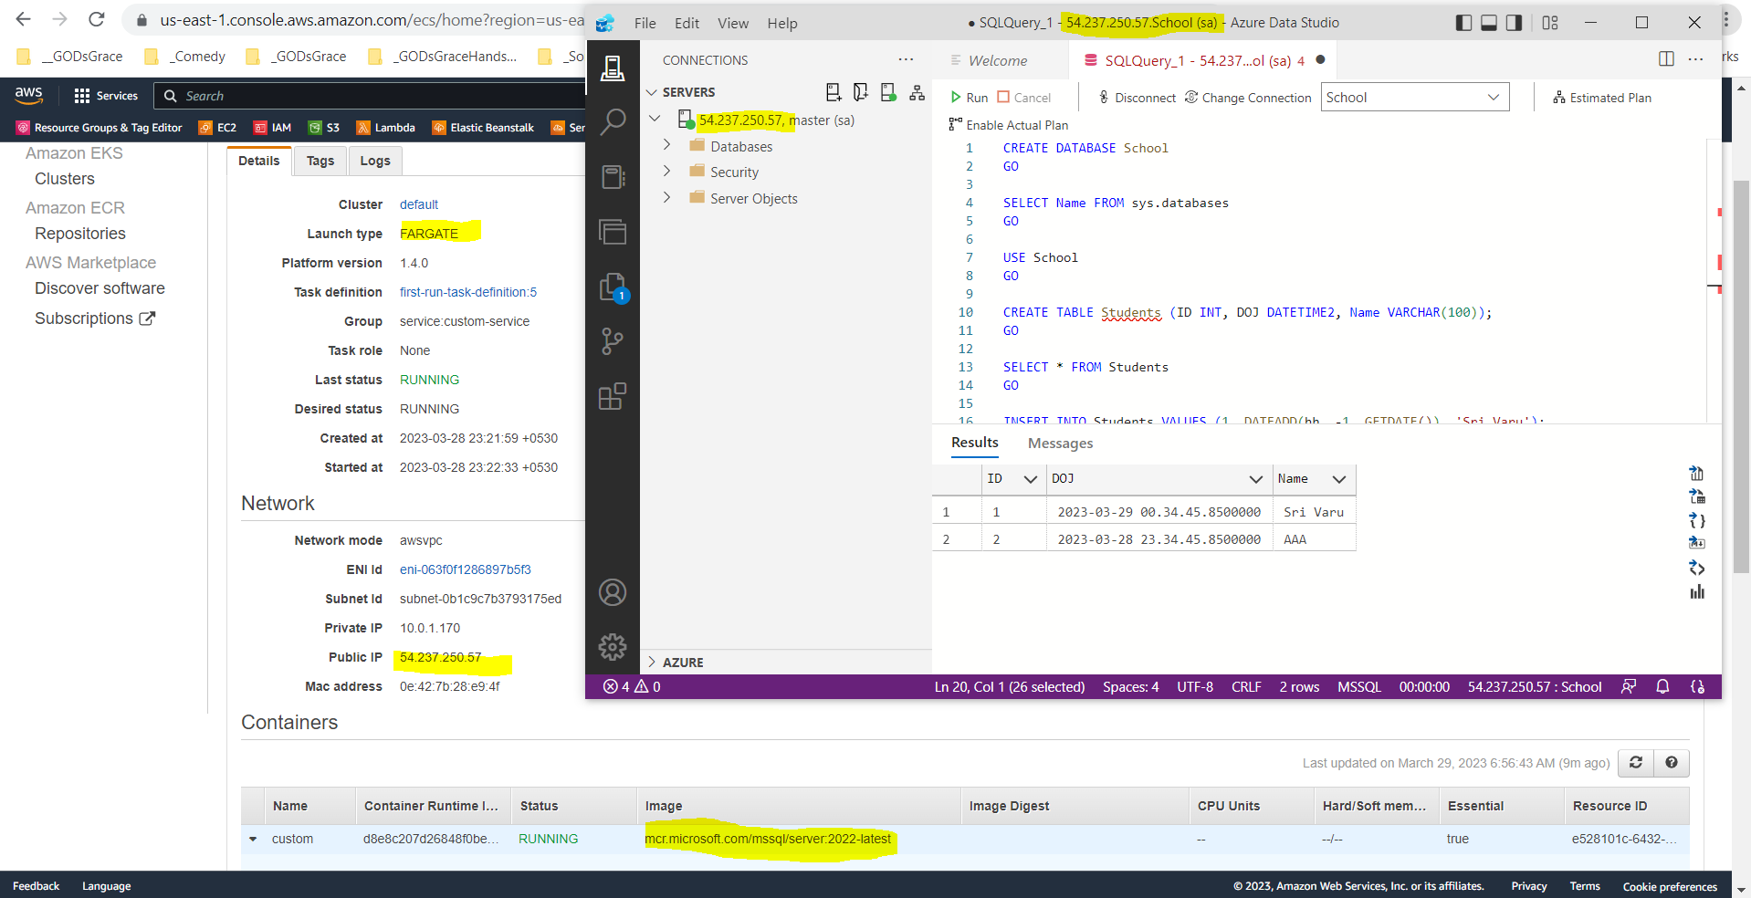

Slide 73
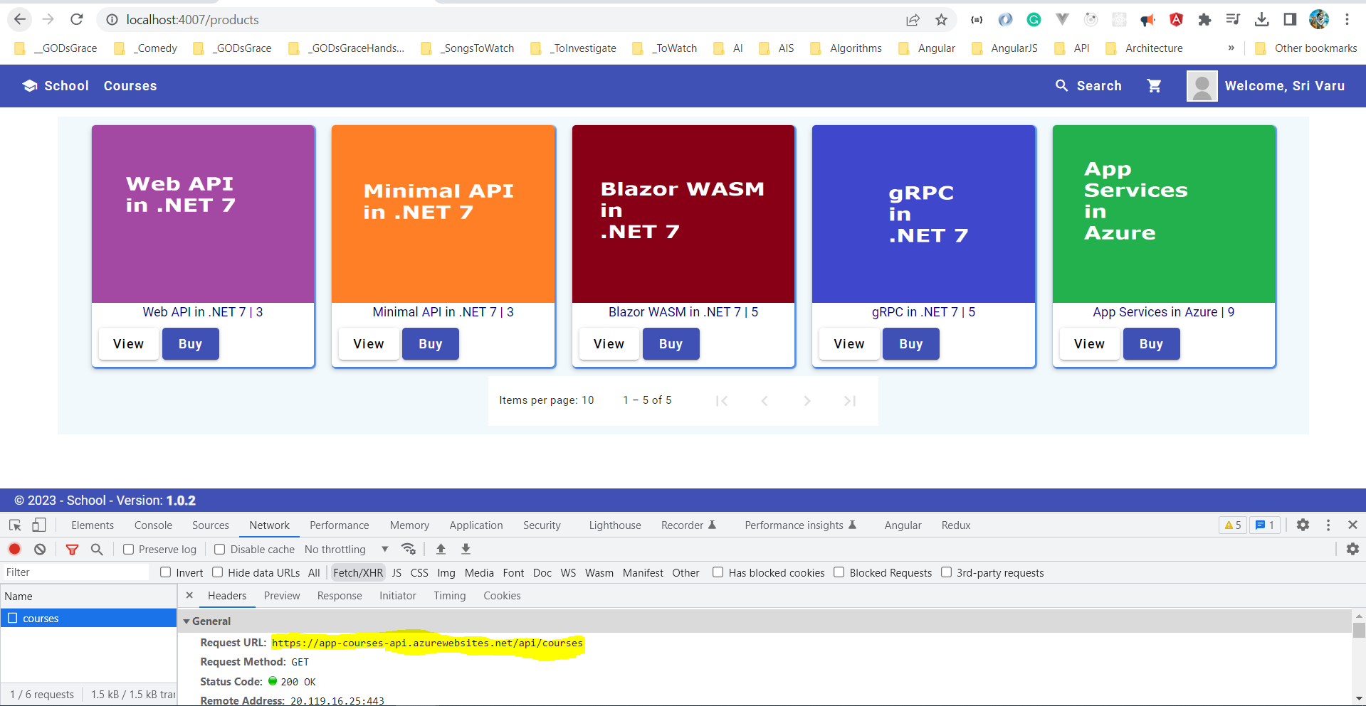

Slide 74
Dotnet Learners House
Minimal API Swagger, Repository, Business, and GitHub Actions
Sunday, Mar 12, 2023
09:00 AM (IST)
Minimal API Swagger, Repository, Business, and GitHub Actions
Viswanatha Swamy
Architect - AIS
Event URL: http://bit.ly/3KHHb2z

Slide 75
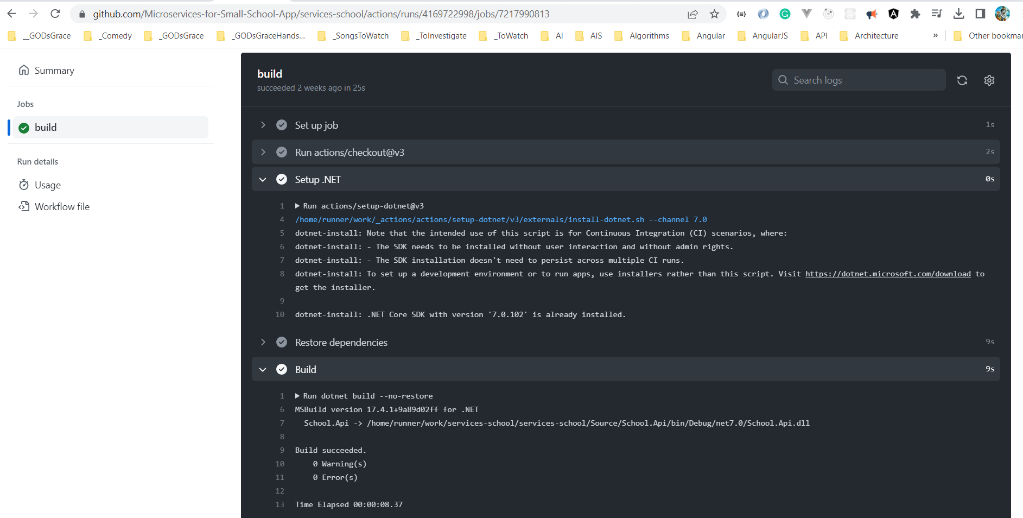

Slide 76
Dotnet Learners House
.NET 7 Minimal API DI, IOC, record, DTOs, Auto Mapper
Sunday, Feb 19, 2023
09:00 AM (IST)
.NET 7 Minimal API DI, IOC, record, DTOs, Auto Mapper
Viswanatha Swamy
Architect - AIS
Event URL: https://bit.ly/40udZl6

Slide 77
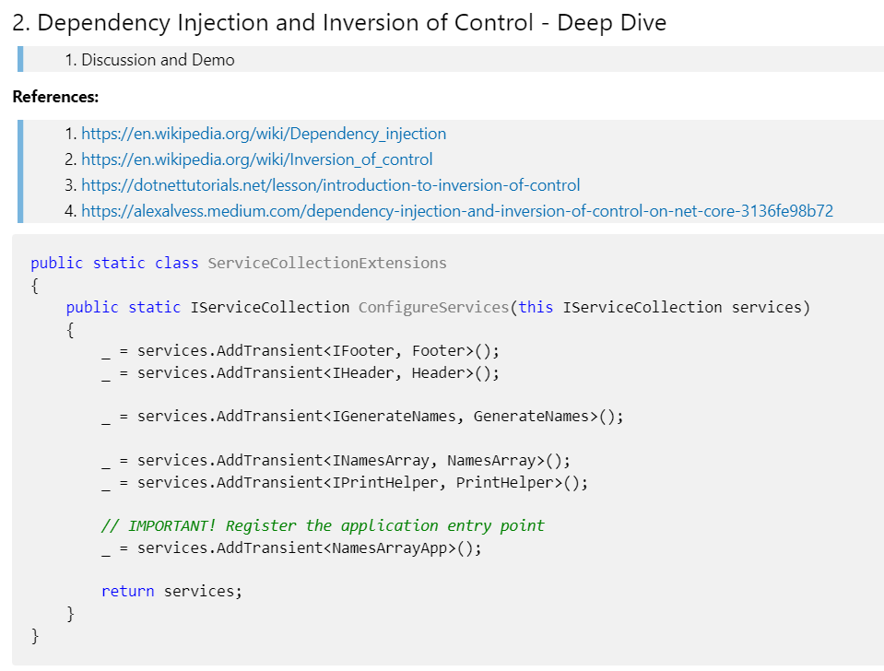

Slide 78
Dotnet Learners House
.NET 6 AWS Creating Docker Images, Deploying to ECS / Fargate
Sunday, Feb 12, 2023
09:00 AM (IST)
.NET 6 AWS Docker Images, Deploying to ECS Fargate
Viswanatha Swamy
Architect - AIS
Event URL: http://bit.ly/3K0gUMM

Slide 79
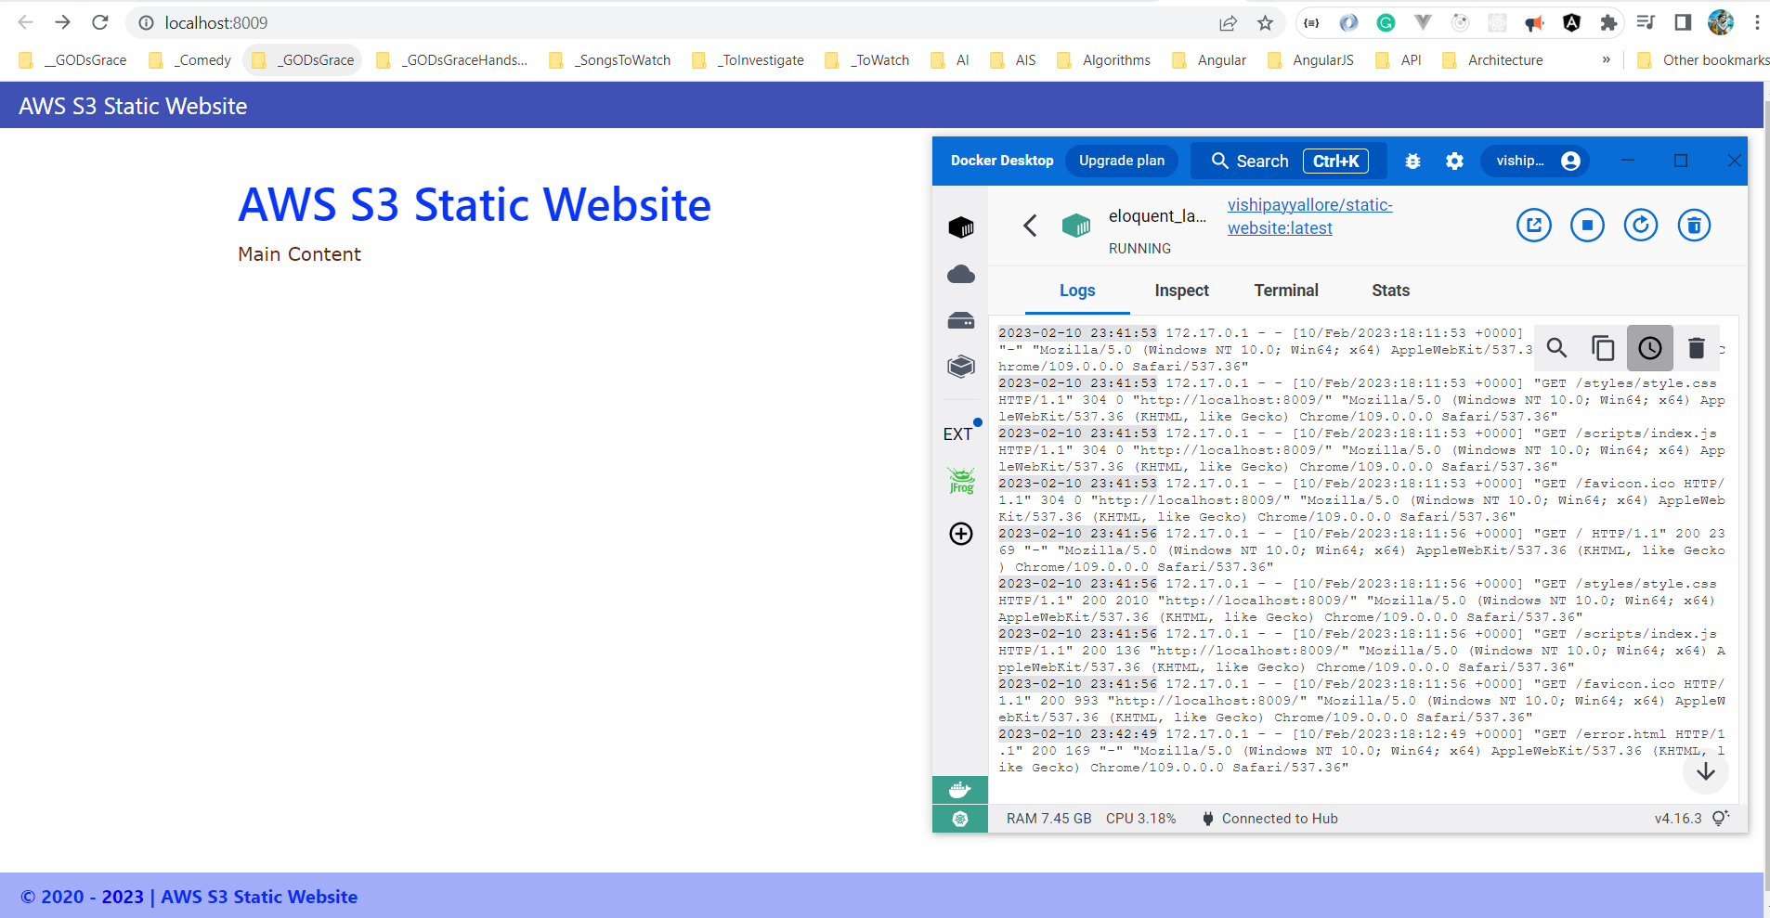

Slide 80
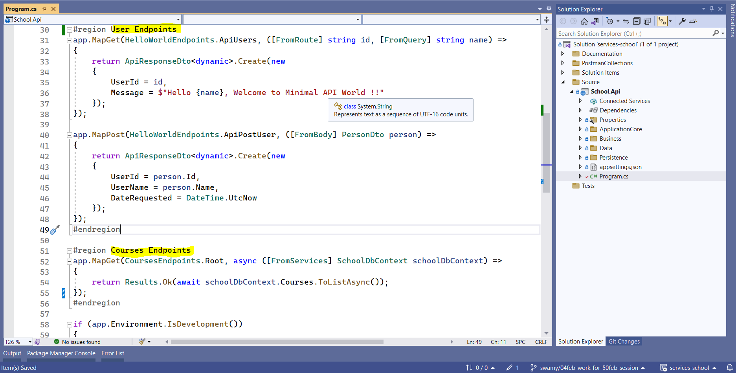

Slide 81
Dotnet Learners House
C# (.NET 6) on AWS - Getting Started With Fargate and ECS
Sunday, Jan 29, 2023
09:00 AM (IST)
C# .NET 6 AWS - Getting Started With Fargate and ECS
Viswanatha Swamy
Associate Architect - AIS
Event URL: http://bit.ly/3XJ7IQB

Slide 82
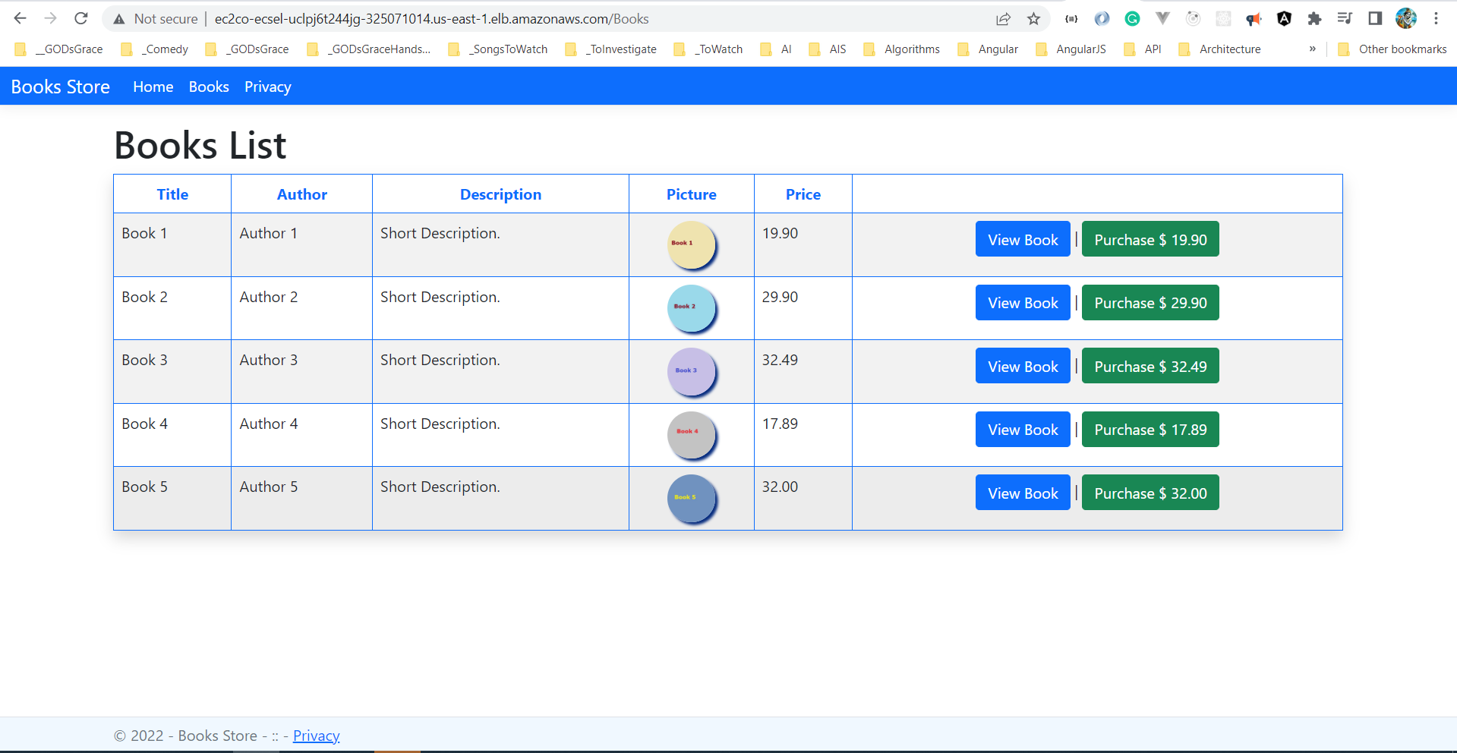

Slide 83
Dotnet Learners House
.NET 7 - Hands on Minimal API with ASP.NET Core, and Static data
Friday, Jan 20, 2023
06:30 AM (IST)
.NET 7 – Hands-on Minimal API with ASP.NET Core
Viswanatha Swamy
Associate Architect - AIS
Event URL: http://bit.ly/3VMeKlX

Slide 84
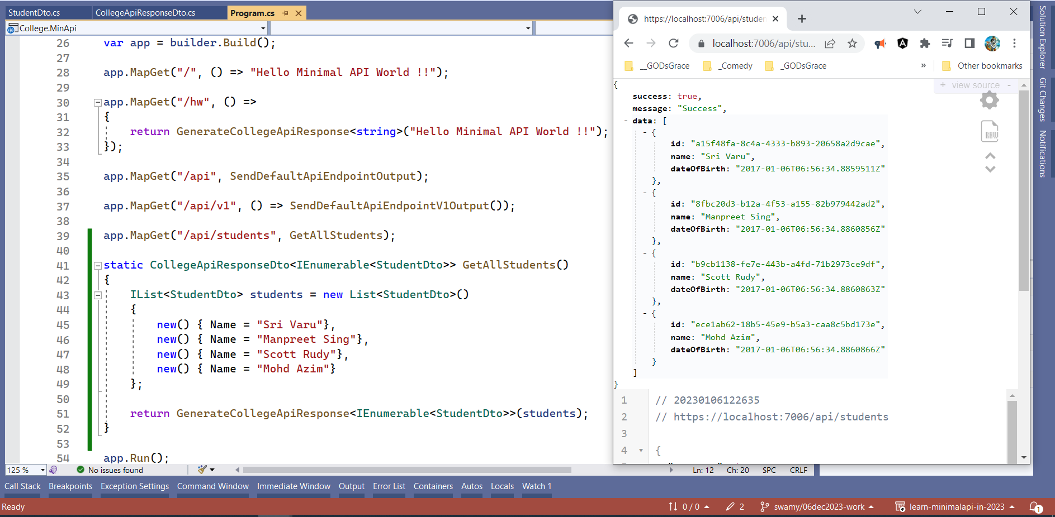

Slide 85
Dotnet Learners House
Lambda Integration S3, SQS, SNS using .NET 6 and C#
Sunday, Dec 25, 2022
10:00 AM (IST)
Lambda Integration S3, SQS, SNS in C# (.NET 6)
Viswanatha Swamy
Associate Architect - AIS
Event URL: https://bit.ly/3WnFNoS

Slide 86
Information
I am still a learner. Apologize if I do any mistake.
All the sessions will be hands on.
Will have parking lots for queries and other topics.
Some of the concepts we will introduced and revisited in next sessions.
There are multiple ways to do, we will use one of the ways.
The focus was more on concepts and demos are kept simple.
C# Corner

Slide 87
Information
I am still a learner. Apologize if I do any mistake.
All the sessions will be hands on.
Will have parking lots for queries and other topics.
Some of the concepts we will introduced and revisited in next sessions.
There are multiple ways to do, we will use one of the ways.
The focus was more on concepts and demos are kept simple.
Pune Tech Community

Slide 88
Front End
Middle Tier
Backend
Core
SQL
Blazor WASM
Angular
ReactJS
Vue.js
APP
API
/
gRPC
BLL
DAL
DMZ

Slide 89




Azure Key Vault
4
1
2
3
5
User
Blazor WASM
Web API
Azure SQL Server
August 2021 Version

Slide 90


Basket API
+
Data Store
API
Gateway
Discount API
+
Data Store
Orders API
+
Data Store
Identity API
+
Data Store

Slide 91
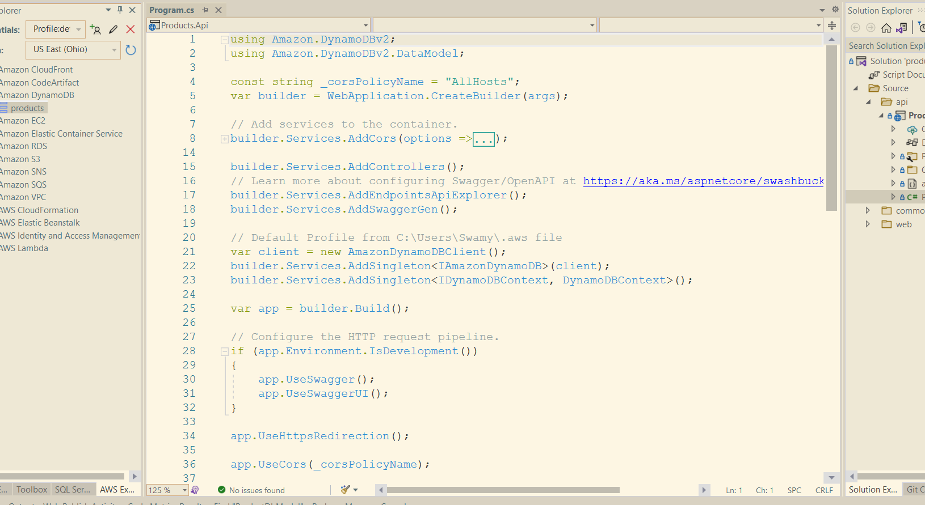




Slide 92
Information
I am still a learner. Apologize if I do any mistake.
All the sessions will be hands on.
Will have parking lots for queries and other topics.
Some of the concepts we will introduced and revisited in next sessions.
There are multiple ways to do, we will use one of the ways.
The focus was more on concepts and demos are kept simple.
Dot Net Learners House

Slide 93




Slide 94






9
Azure Key Vault
6
Azure Redis Cache
8
Blazor WASM
1
2
JWT
4
5
API Mgmt
Web API
7
3
Azure SQL Server
Auth0
High Lights:
Blazor WASM UI get authenticated and pass the JWT to APIM.
APIM Validates the JWT and routes the request to Web API.
SQL Server, and Redis Cache’s credentials are stored in Azure Key Vault.
Web API investigates Azure Redis Cache before hitting SQL Azure. (Cache Aside Pattern)
We will preform Dacpac (.sqlproj) for deployment of SQL Data Store.

Slide 95
9
Azure Key Vault
6
Azure Redis Cache
8
Blazor WASM
1
2
JWT
4
5
API Mgmt
Web API
7
3
Azure SQL Server
Auth0
High Lights:
Blazor WASM UI get authenticated and pass the JWT to APIM.
APIM Validates the JWT and routes the request to Web API.
SQL Server, and Redis Cache’s credentials are stored in Azure Key Vault.
Web API investigates Azure Redis Cache before hitting SQL Azure. (Cache Aside Pattern)
We will preform Dacpac (.sqlproj) for deployment of SQL Data Store.

Slide 96
Information
All the sessions will be hands on.
Will have parking lots for queries and other topics.
Some of the concepts we will introduced and revisited in next sessions.
There are multiple ways to do, we will use one of the ways.
The focus was more on concepts and demos are kept simple.
I am still a learner. What!!! … wait … Yes, I am still a learner.
Microsoft Reactor Bengaluru

Slide 97
Information
I am still a learner. What!!! … Yes, I am still a learner. Apologize if I do any mistake.
All the sessions will be hands on.
Will have parking lots for queries and other topics.
Some of the concepts we will introduced and revisited in next sessions.
There are multiple ways to do, we will use one of the ways.
The focus was more on concepts and demos are kept simple.
Power Platform Classmates

Slide 98
Information
All the sessions will be hands on.
Will have parking lots for queries and other topics.
Some of the concepts we will introduced and revisited in next sessions.
There are multiple ways to do, we will use one of the ways.
The focus was more on concepts and demos are kept simple.
I am still a learner. What!!! … wait … Yes, I am still a learner.
Global Azure 2021 - India

Slide 99
Information
I am still a learner. Apologize if I do any mistake.
All the sessions will be hands on.
Will have parking lots for queries and other topics.
Some of the concepts we will introduced and revisited in next sessions.
There are multiple ways to do, we will use one of the ways.
The focus was more on concepts and demos are kept simple.
https://www.azconf.dev

Slide 100










This Photo by Unknown Author is licensed under CC BY-SA-NC
This Photo by Unknown Author is licensed under CC BY
This Photo by Unknown Author is licensed under CC BY
This Photo by Unknown Author is licensed under CC BY
This Photo by Unknown Author is licensed under CC BY-SA
This Photo by Unknown Author is licensed under CC BY-NC-ND

Slide 101
Information
All the sessions will be hands on.
Will have parking lots for queries and other topics.
Some of the concepts we will introduced and revisited in next sessions.
There are multiple ways to do, we will use one of the ways.
The focus was more on concepts and demos are kept simple.
I am still a learner. What!!! … wait … Yes, I am still a learner.
AIS

Slide 102
Information
All the sessions will be hands on.
Will have parking lots for queries and other topics.
Some of the concepts we will introduced and revisited in next sessions.
There are multiple ways to do, we will use one of the ways.
The focus was more on concepts and demos are kept simple.
I am still a learner. What!!! … wait … Yes, I am still a learner.
mobconf

Slide 103
Information
All the sessions will be hands on.
Will have parking lots for queries and other topics.
Some of the concepts we will introduced and revisited in next sessions.
There are multiple ways to do, we will use one of the way.
The focus was more on concepts and demos are kept simple.
I am still a learner. What!!! … wait … Yes, I am still a learner.
BDotNet

Slide 104
Information
All the sessions will be hands on.
Will have parking lots for queries and other topics.
Some of the concepts we will introduced and revisited in next sessions.
There are multiple ways to do, we will use one of the way.
The focus was more on concepts and demos are kept simple.
I am still a learner. What!!! … wait … Yes, I am still a learner.
Hyderabad Power Apps and Power Automate UG

Slide 105
Information
All the sessions will be hands on.
Will have parking lots for queries and other topics.
Some of the concepts we will introduced and revisited in next sessions.
There are multiple ways to do, we will use one of the way.
The focus was more on concepts and demos are kept simple.
I am still a learner. What!!! … wait … Yes, I am still a learner.
The Tech Platform

Slide 106
Information
All the sessions will be hands on.
Will have parking lots for queries and other topics.
Some of the concepts we will introduced and revisited in next sessions.
There are multiple ways to do, we will use one of the way.
The focus was more on concepts and demos are kept simple.
I am still a learner. What!!! … wait … Yes, I am still a learner.
Angular Hyderabad

Slide 107




Slide 108
Please fasten
your
seat belt !!!
Dot Net Learners House

Slide 109
Q & A
Dot Net Learners House

Slide 110
Thank You
Viswanatha Swamy
LinkedIn: https://www.linkedin.com/in/viswanatha-swamy-b57326128/
Twitter: https://twitter.com/vishipayyallore
Dot Net Learners House

